Slide 1
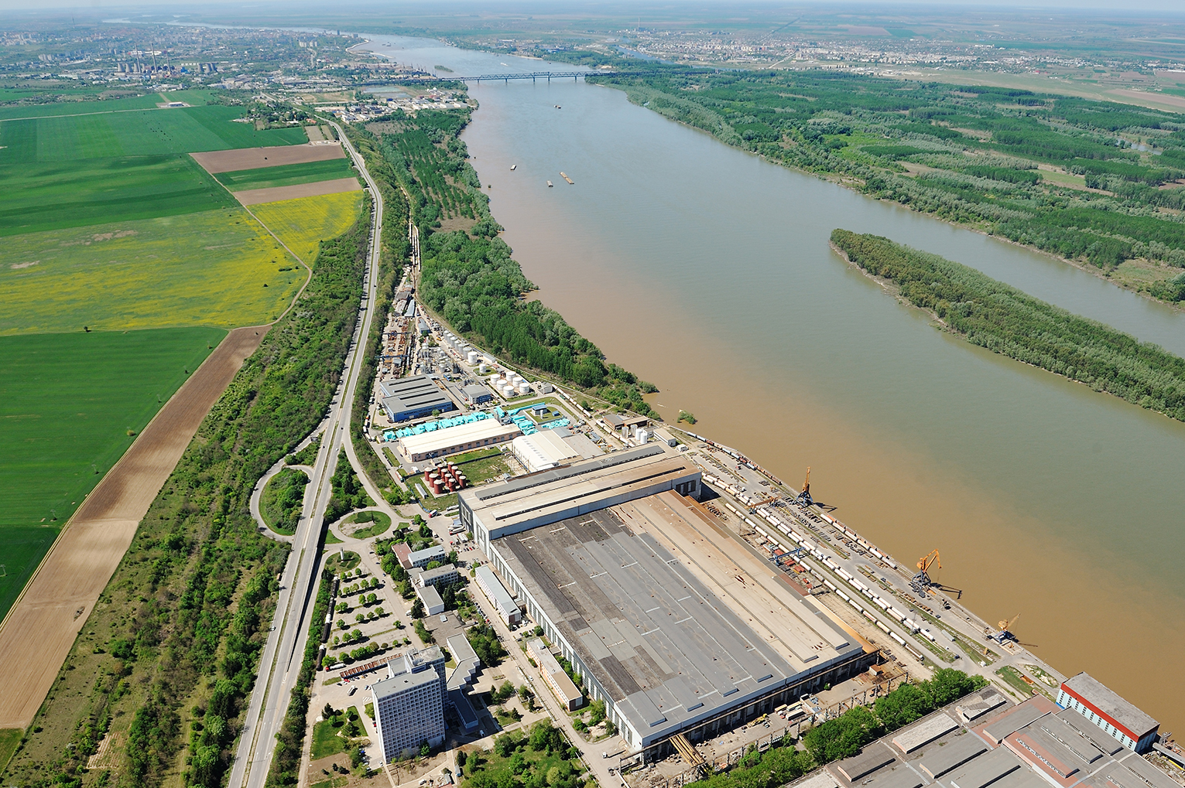
BULMARKET DM Ltd.
“Pioneer in every bussiness”

Slide 2
Who we are ?
BULMARKET GROUP
Bulmarket DM
Bulmarket LPG & LNG
Bulmarket CNG
Bulmarket Port
Bulmarket Rail Cargo
Bulmarket Auto Transport
Bulmarket Kyustendil
Bravo Sped
Bulmarket Security
---------------------------------------------
Citygas Galati
Gaz Terminal Giurgiu
PRODUCTION DIVISION
Vegoil Plant “Oleo Protein”
Biodiesel Plant “Astra Bioplant”
Biodiesel Plant “Oberosterreichische biodiesel Bulgaria”

Slide 3
History
BULMARKET DM Ltd. was founded in 1996 and nowadays is among the first 100 leading companies in Bulgaria, operating on the international markets.
1996 | 1998 | 1999 | 2000 | 2001 | 2002 | 2003 | 2004 | 2005 | 2006 | 2007 | 2008 | 2009 | 2010 | 2011 | 2012 | 2013 | 2015
Bulmarket DM was established
PORT Bulmarket
First BG Railway private operator
Astra Bioplant biodiesel production
OÖ Biodiesel Enns , Austria
Oleo Protein
crude oil & meal production
OÖ Biodiesel Bulgaria biodiesel production
May 9, 1996
Nov, 2001
Oct, 2005
Oct, 2008
July, 2010
June, 2012
March 2013
Dec, 2001
May, 2003
Nov, 2004
Dec, 2006
May, 2007
2008 - 2009
2013 - 2015
First river LPG terminal
First
CNG filling station
LPG tanker BRIZ (Bulmarket 1)
Galati LPG river terminal
LPG tanker POLARIS
Excise storages 4 in Bg,
2 in Ro
First LNG terminal in BG
Trade & Logistic Development
Industrial Development

Slide 4
Our clients
LPG/CNG/LNG
EKO Bulgaria
Aurubis
ZARA Energy
PST Group
OMV Bulgaria
Rompetrol Bulgaria
NIS Petrol (GAZPROM)
Motor Oil (Greece)
Helenic Petroleum (Greece)
Knauf (Macedonia)
Makpetrol (Macedonia)
NIS (Serbia)
AKPET (Lukoil,Turkey)
Lukoil Bulgaria
LITASKO (Switzerland)
Ecogas CNG
Enesy
М gas
Sigma gas
Rail / Port / Auto
Rompetrol Bulgaria
INSA Oil
Saksa Fuels
Astra Bioplant
Polysan
ThyssenKrupp
MOL (Hungary)
Slovnaft (Slovakia)
Lukoil Bulgaria
INTERKOM
VIAND Bulgaria
TM Technology
HUS Steel
Steel Impeks
BUNGE Bulgaria
Quartzwerke Bulgaria
Vegoil / Biodiesel
Lukoil Bulgaria
OMV Bulgaria
Rompetrol Bulgaria
OMV Petrom Romania
Rompetrol Romania
MOL Romania
MOL Hungary
Helenic Petroleum
Motor Oil (Greece)
PETROINEOS
Baltic fuels
EDF MAN (Italy)
Avicola Romania
Vienna Biodiesel (Austria)
VIAND Bulgaria

Slide 5
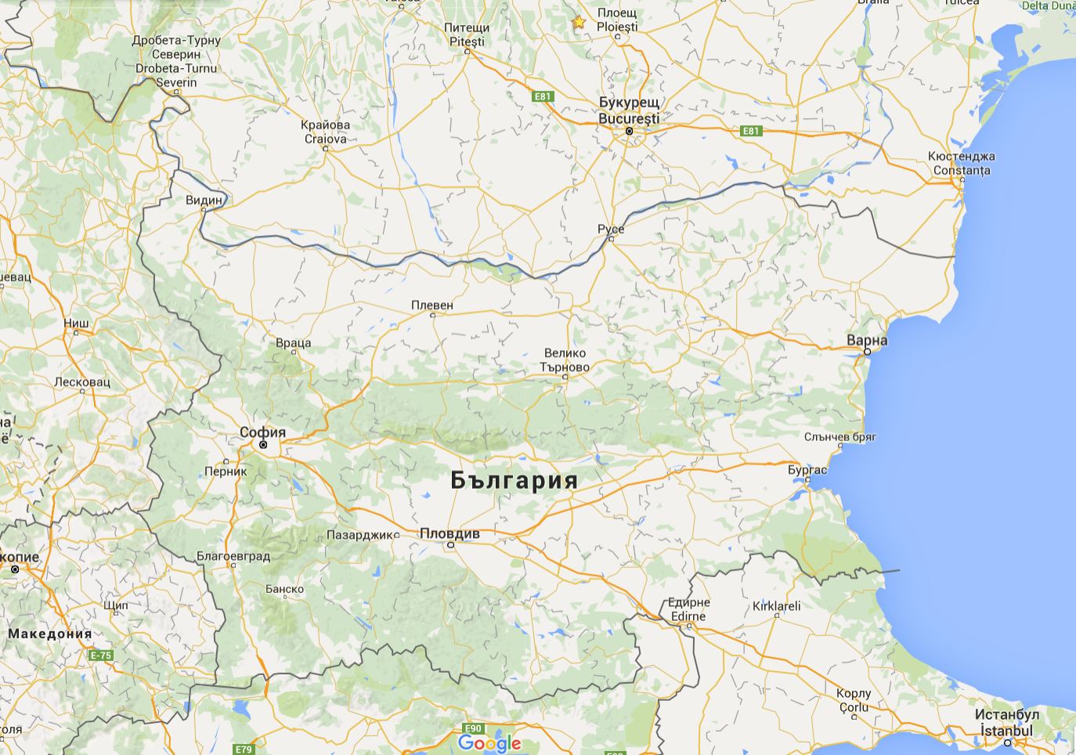
Bulgaria

Slide 6
Activities in BG
Fuels storage & trading
CNG stations
LNG terminals
Rail activities
Port activities
Autotransport
Vegoil production
Biodiesel production

Slide 7
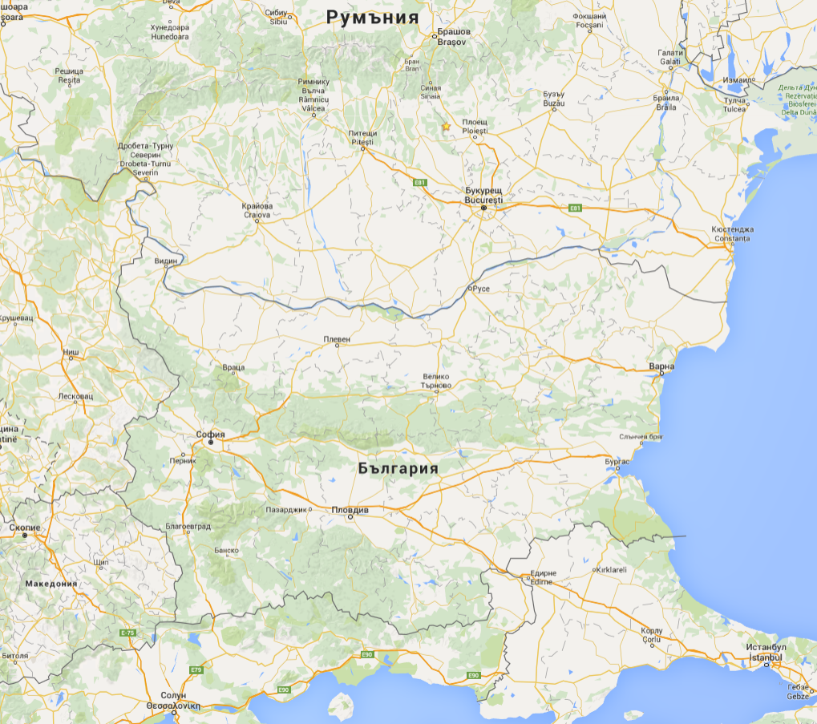
Romania

Slide 8
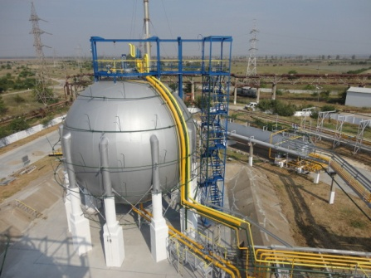
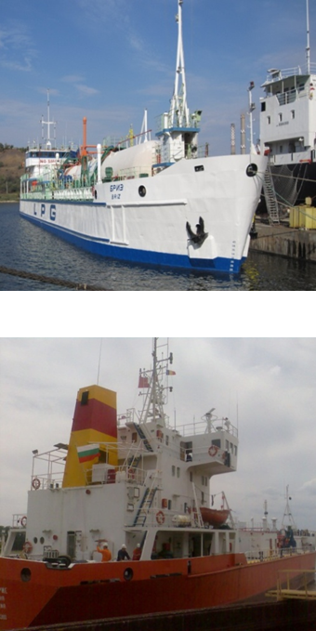
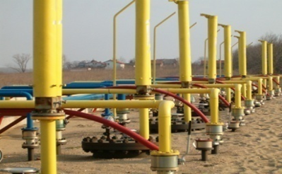
Bulmarket LPG
6 LPG warehouses 4 in BG, 2 in RO
160 LPG Rail tankcars
2 LPG tankers
4 LPG barges
17 trucks
> 180 ktons LPG/year
> 30 ktons petroleleum products/year
> 60 ktons bitumen/year

Slide 9
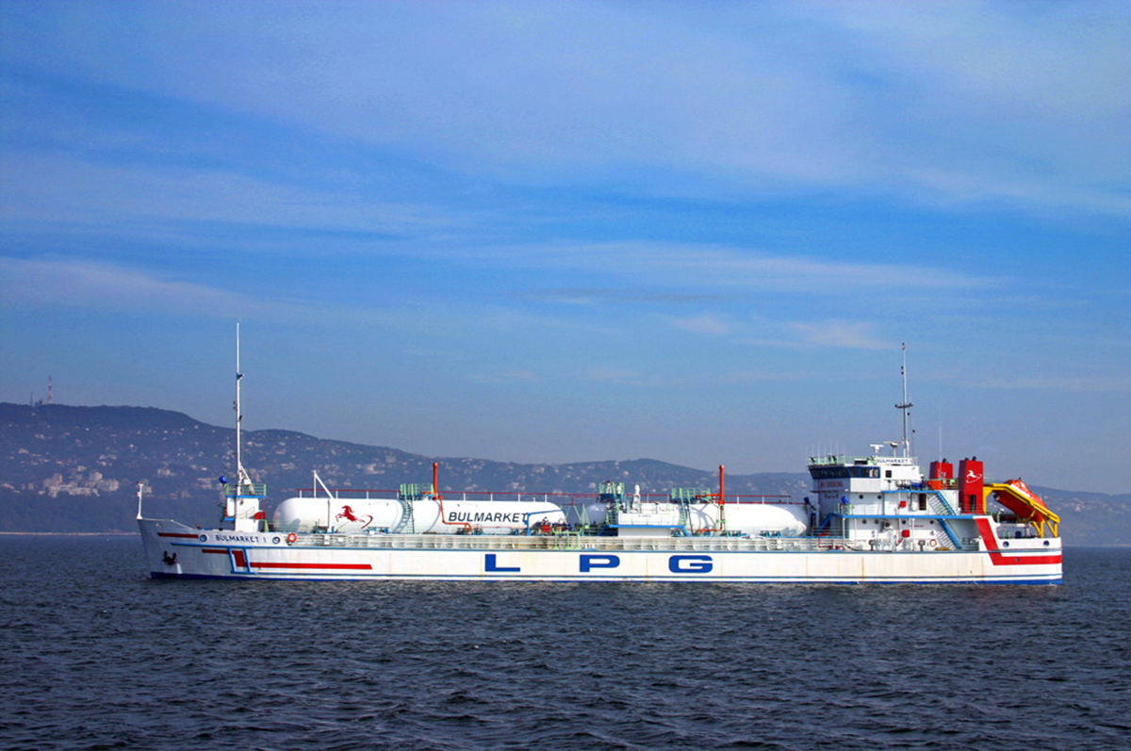
Bulmarket LPG

Slide 10
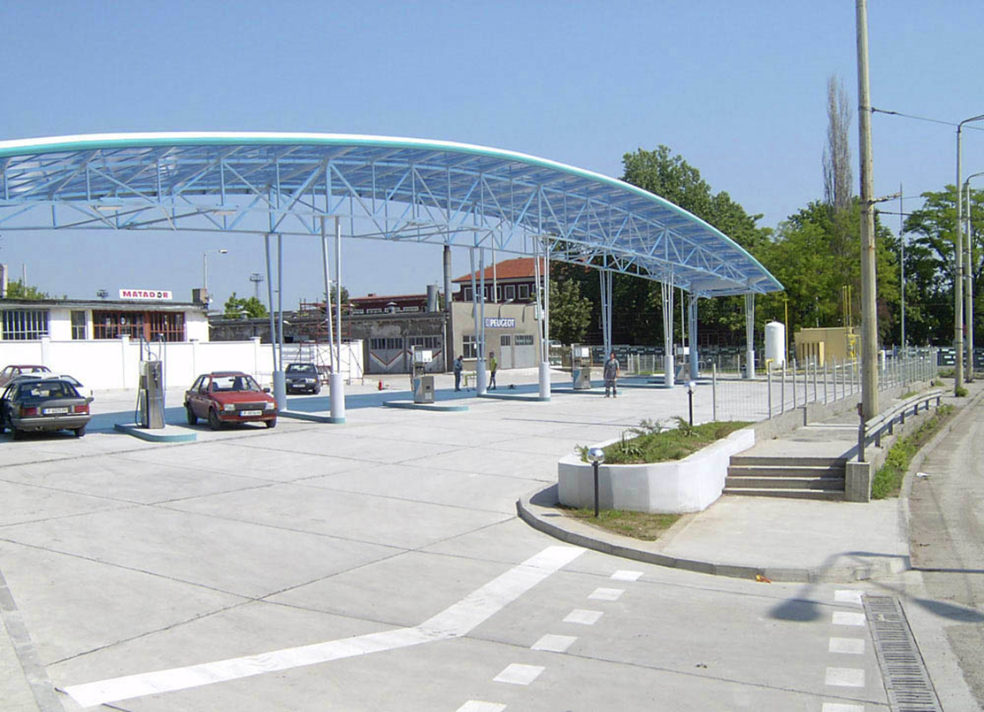
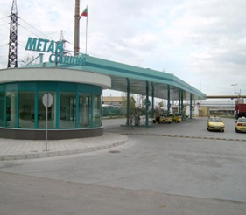
Bulmarket CNG
7 CNG refueling stations
9 compressors
> 11.000 m3/h capacity
> 2 000 refueling per day
> 8 mln. m3/year NG

Slide 11
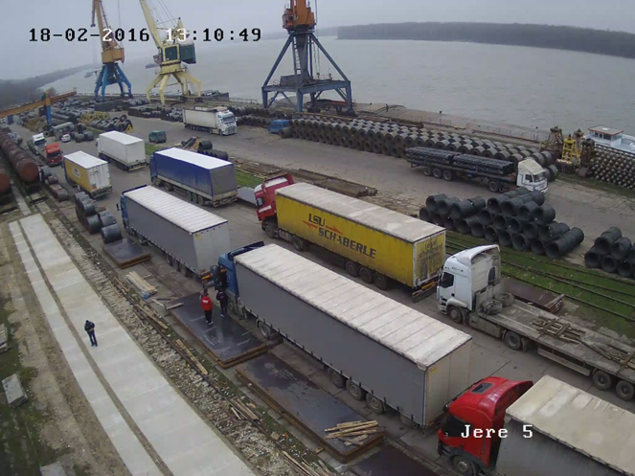
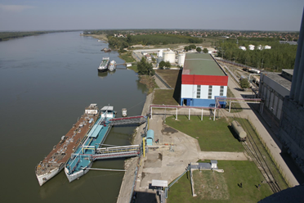
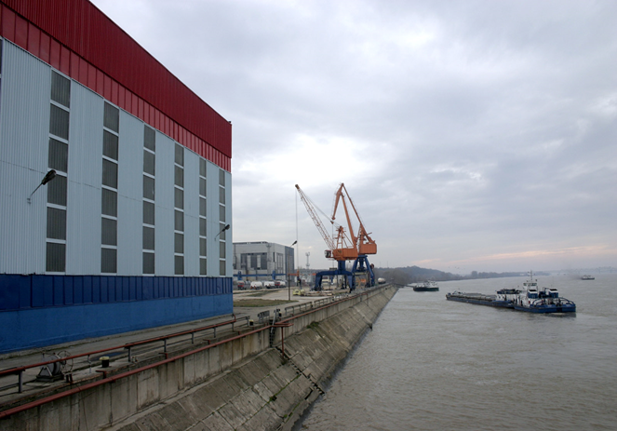
Bulmarket Port
Biggest private port on Danube
7 specialized piers
4 general cargo
2 dangerous goods
1 bulk cargo products
5 quay cranes
> 500 ships/year
> 774 ktons transhiped goods/year

Slide 12
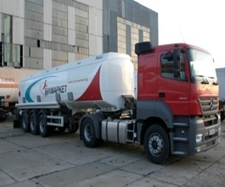
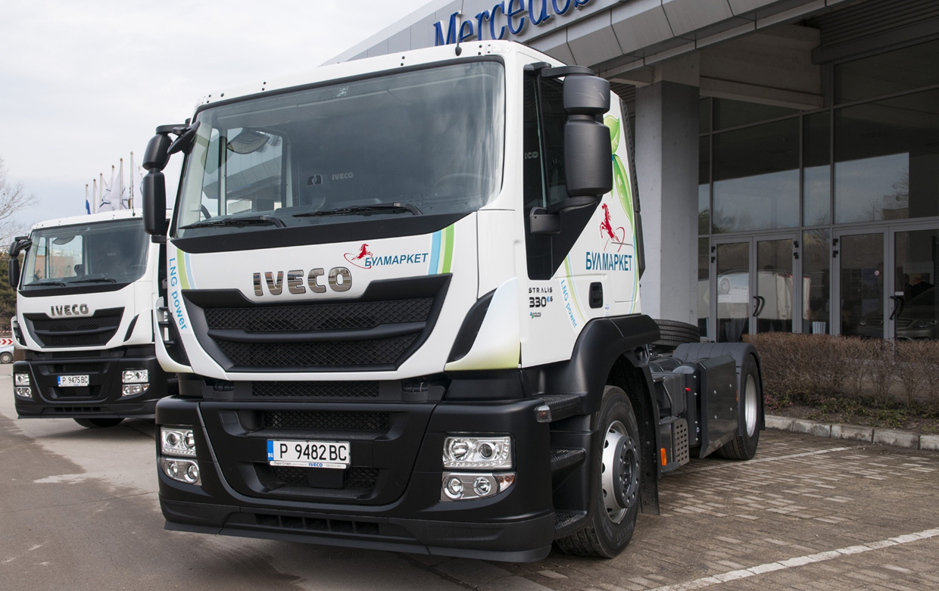
Bulmarket Auto
4 transport hubs
29 trucks
10 semitrailers
> 1.4 mln. km/year
> 230 ktons/year transported goods

Slide 13
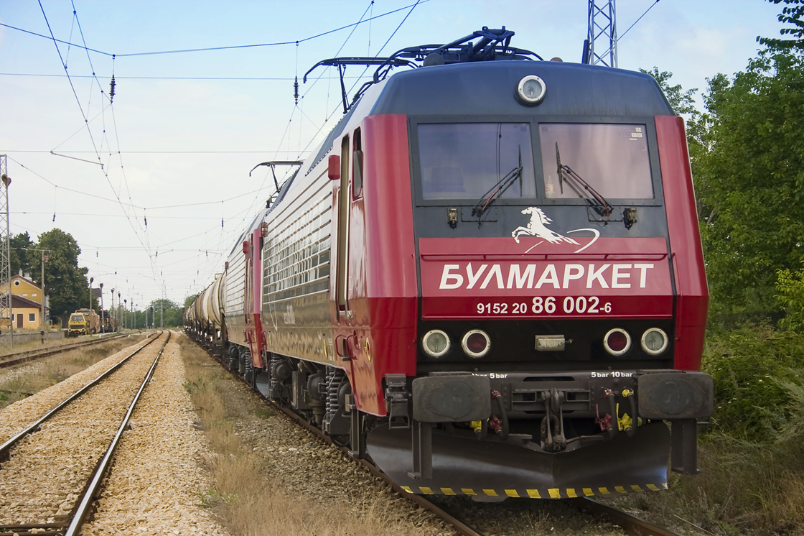
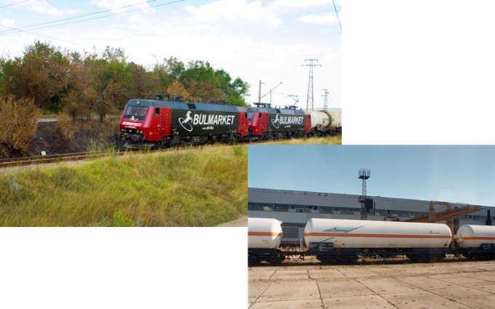
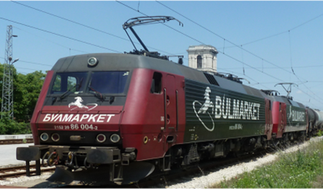
Bulmarket Rail Cargo
The first licensed private railway undertaking in Bulgaria
17 electric locomotives series 86 & 87
11 diesel shunting locomotives
250 own wagons
15 LPG
80 sulfuric acid (H₂SO₄)
86 grain products
59 rail tank cars petroleum products
10 open top bulk cargo wagons
290 long term rented wagons
150 LPG
140 rail tank cars petroleum products
> 2500 trains/year
> 568 mln. Brutto ton km/year

Slide 14
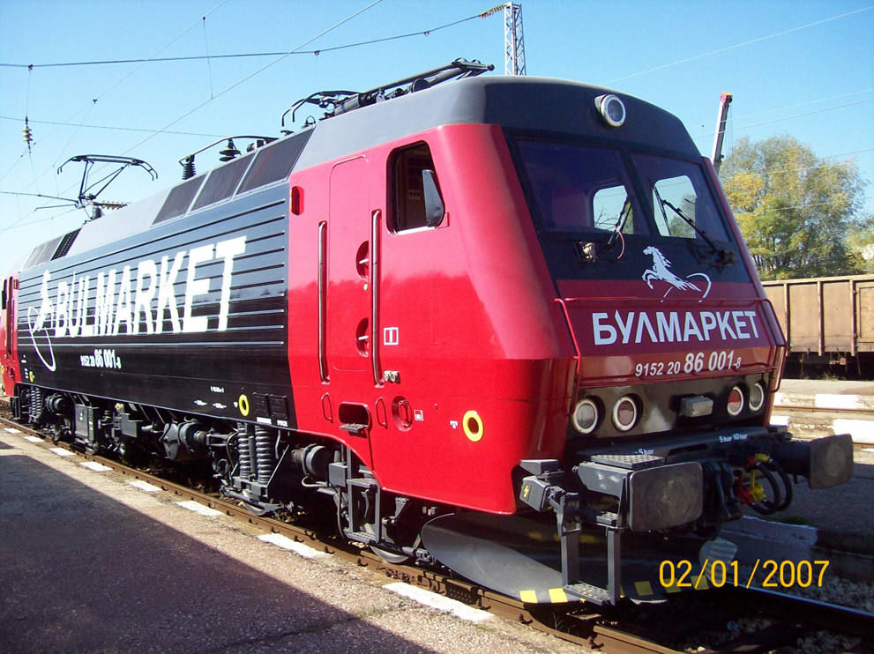
Bulmarket Rail Cargo
Serie 86, 4 MW

Slide 15
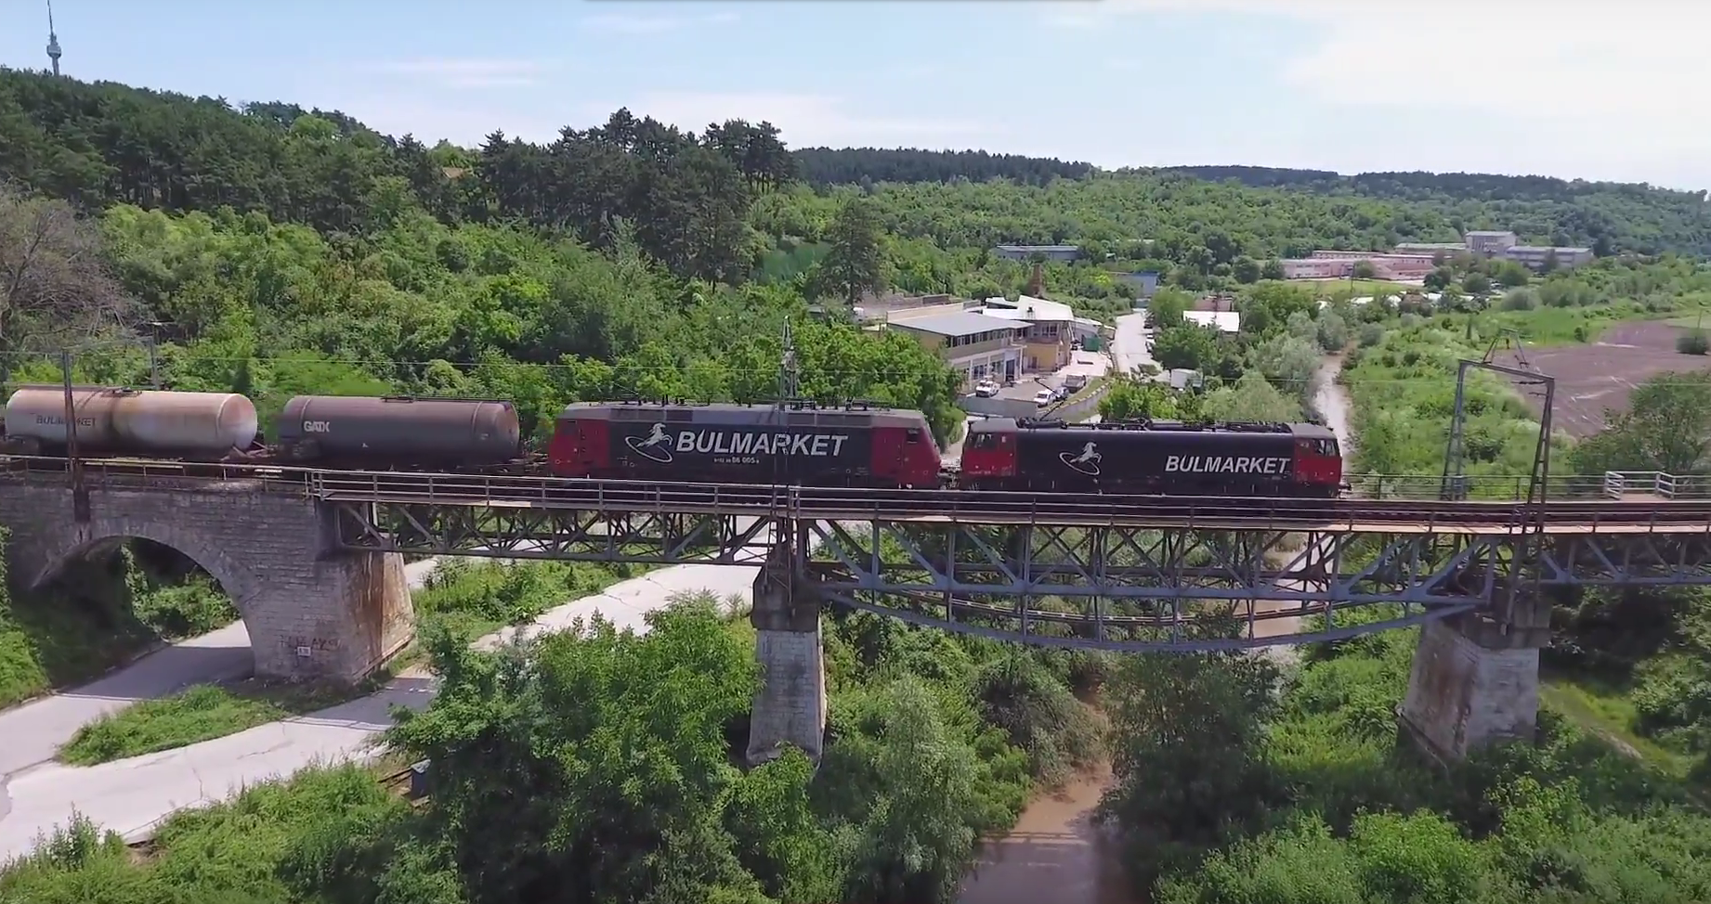
Bulmarket Rail Cargo

Slide 16
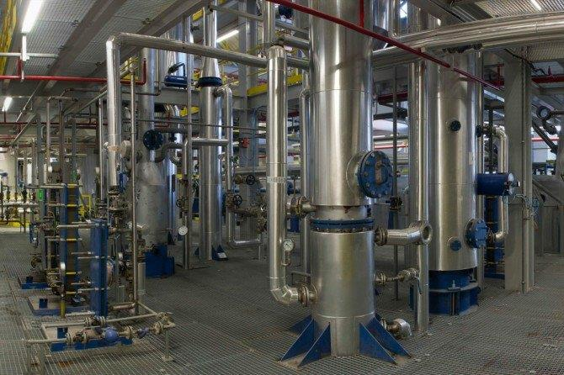
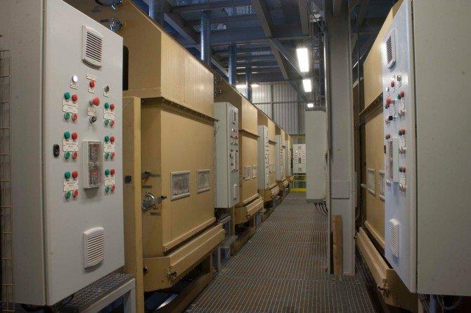
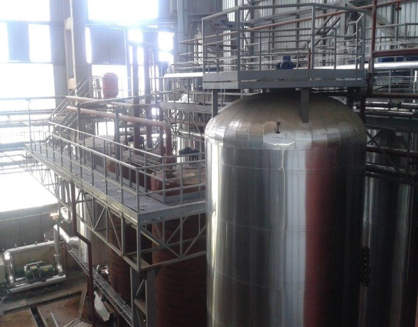
Vegetable Oil Plant “Oleo protein”
One of the biggest oil plants in Bulgaria
5 specialized sub-plants
Pressing-preparation
Extraction
Deguming
Winterization
Meal peletizing
> 300 ktons/year grain
> 100 ktons/years vegoil
> 150 ktons/years by-products

Slide 17
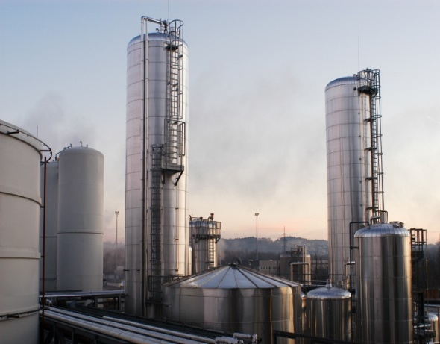
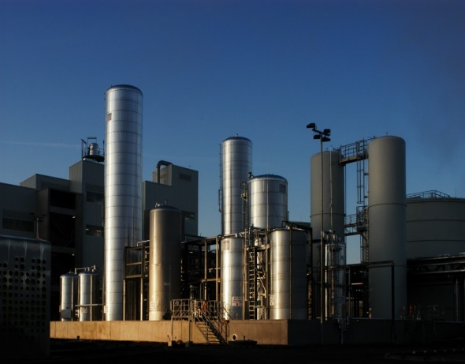
Biodiesel Plant “Oberosterreichische biodiesel Bulgaria”
The only one biodiesel plant in Bulgaria
4 specialized sub-plants
Refinery
Trans esterification
Glycerol
Distillation
Storage
> 100 ktons/year biodiesel
> 11 ktons/years pharma glycerol
> 2 ktons/years by-products

Slide 18
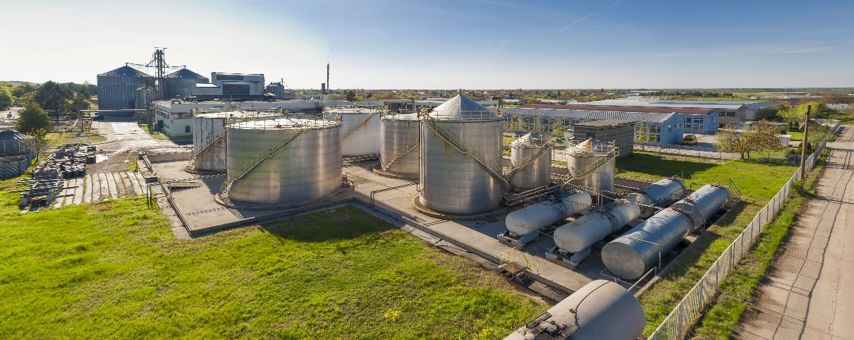
Biodiesel Plant “Astra Bio Plant”
The first biodiesel plant in Bulgaria
4 specialized sub-plants
Refinery
Trans esterification
Glycerol
Distillation
Meal pelletizing
> 60 ktons/year biodiesel
> 6 ktons/years glycerol
> 35 ktons/years by-products

Slide 19
What’s new?

Slide 20
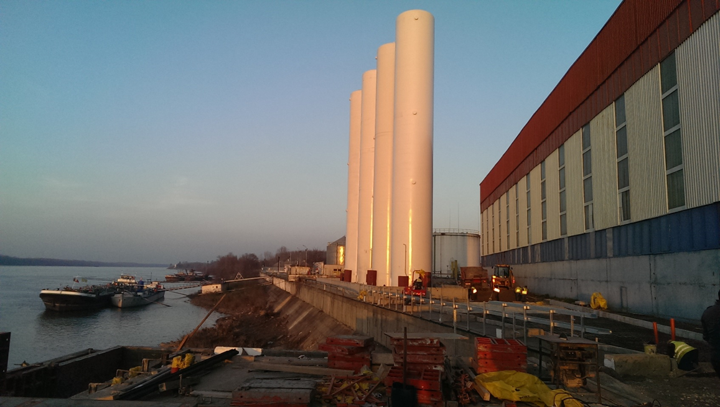
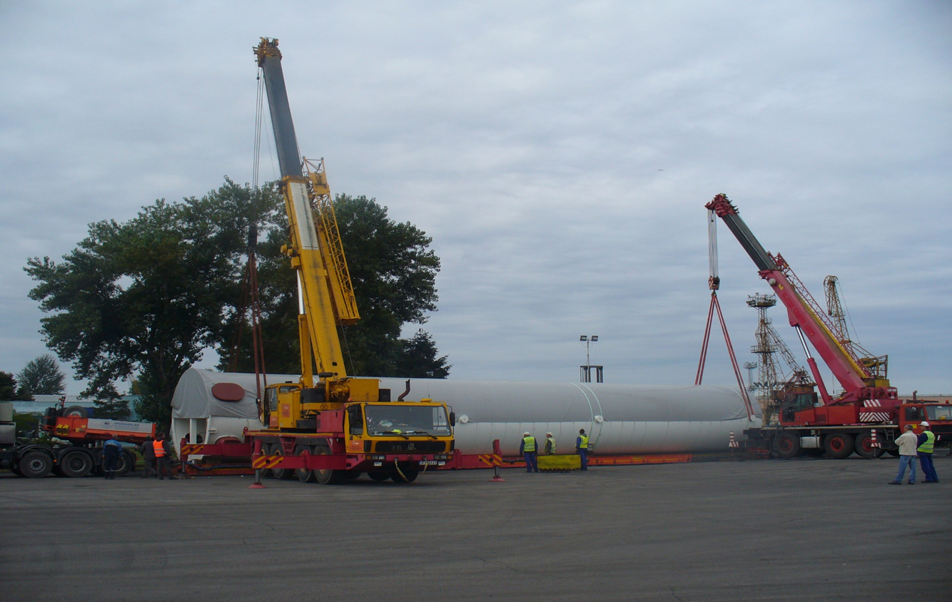
Bulmarket LNG
I phase
4 x 250 m3 vertical LNG tanks
connection with terminal for dangerous goods loading/unloading
river ships bunkering
LNG station for fuel for the delivery trucks
3 trucks Iveco 330 for delivery of LNG, driven by LNG
II phase
LNG terminals in Sofia & Plovdiv
delivering of LNG for industrial customers by trucks
retrofitting 70 existing end-users
connection to the existing natural gas distribution network – BOG, regasification, peak-shaving

Slide 21
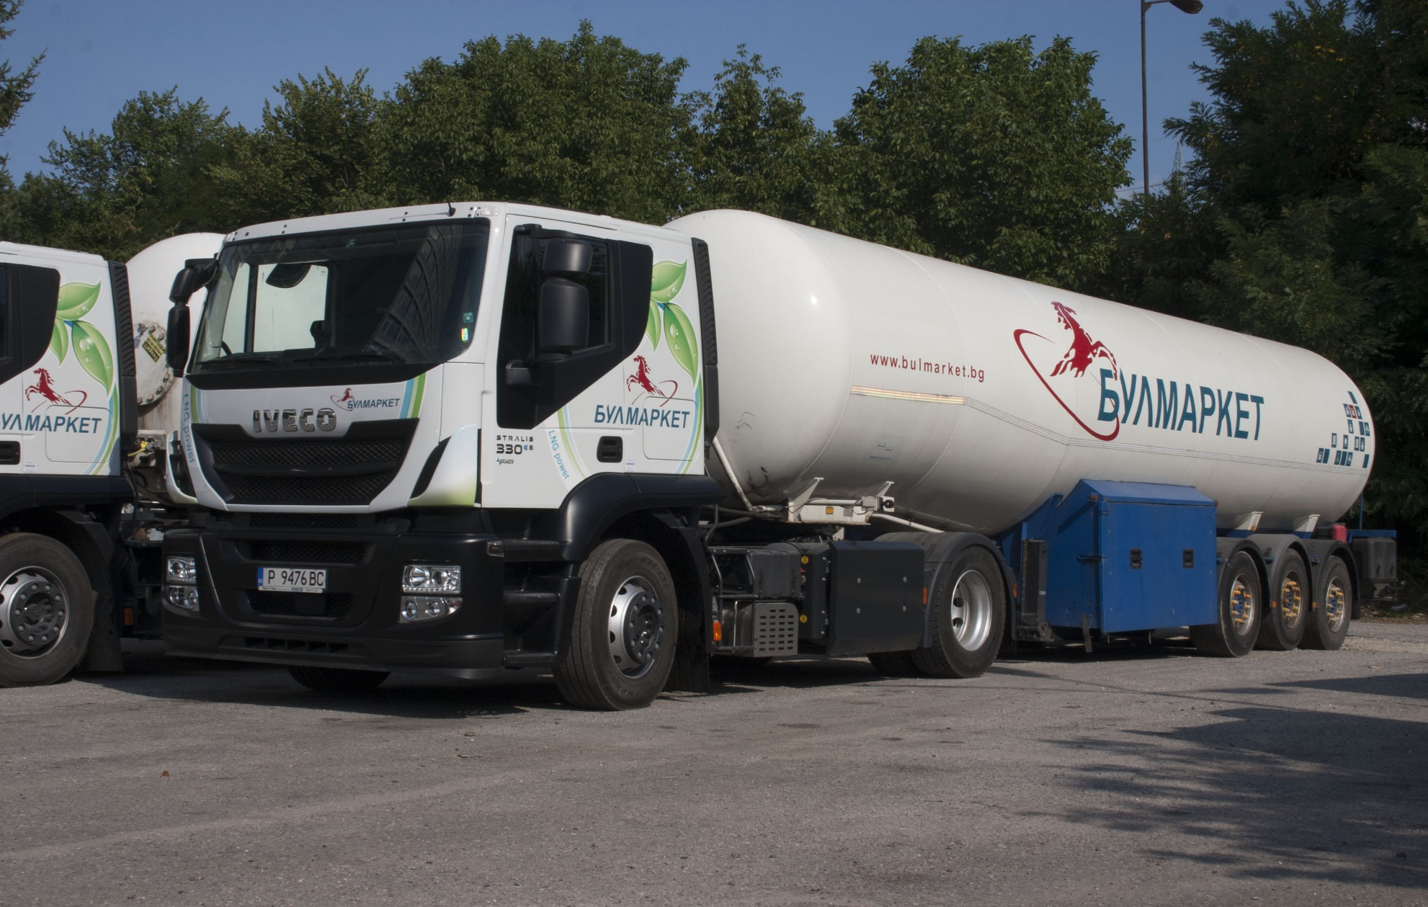
Bulmarket LNG

Slide 22
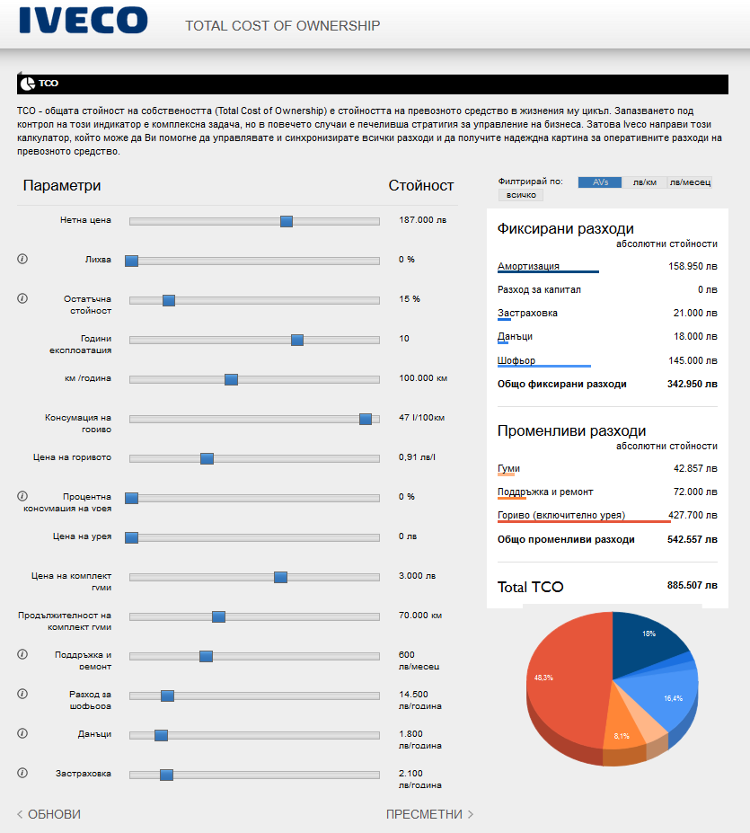
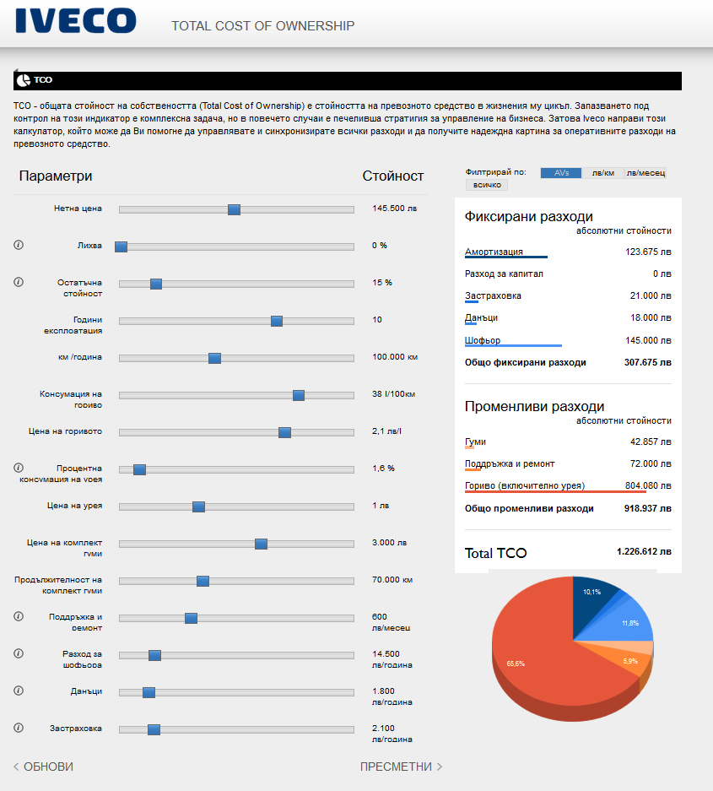
Bulmarket LNG

Slide 23
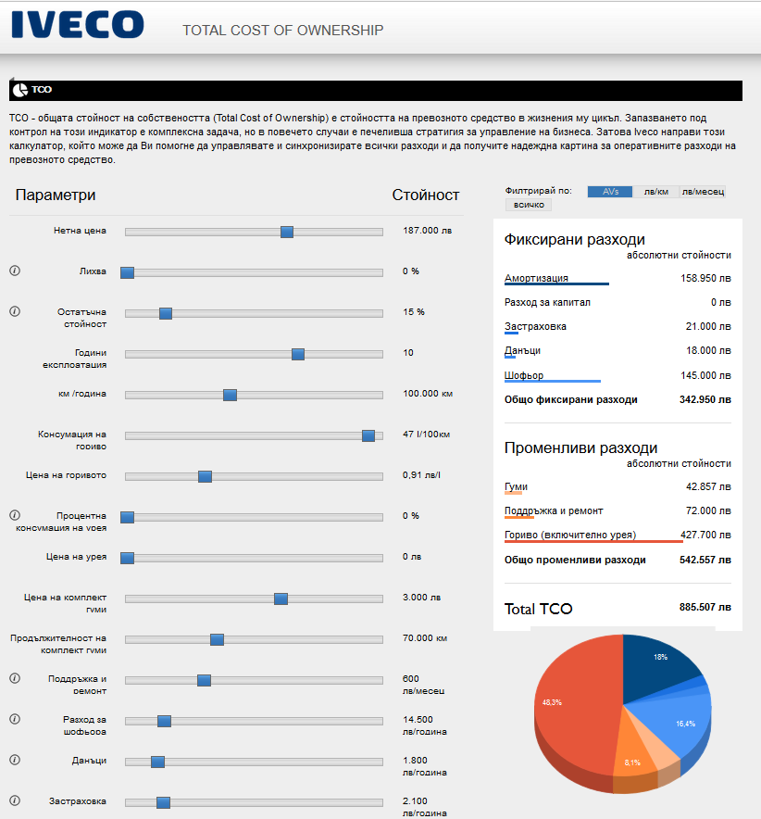
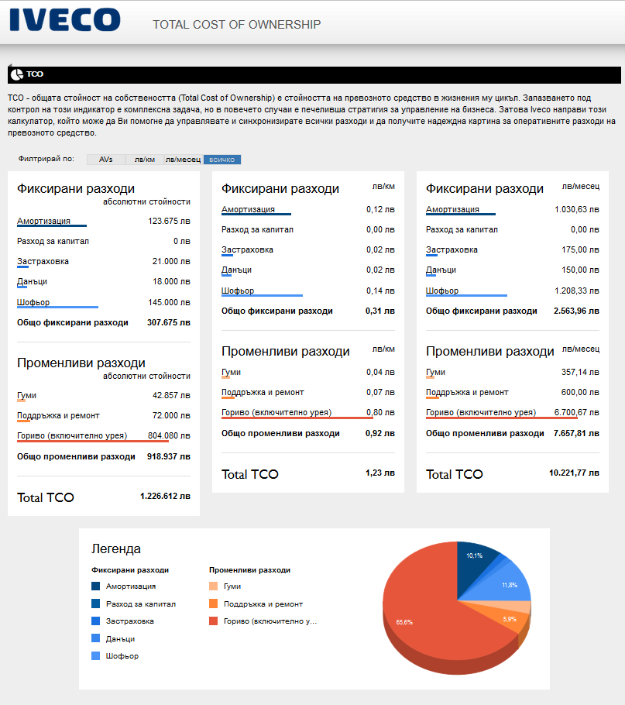
Bulmarket LNG

Slide 24
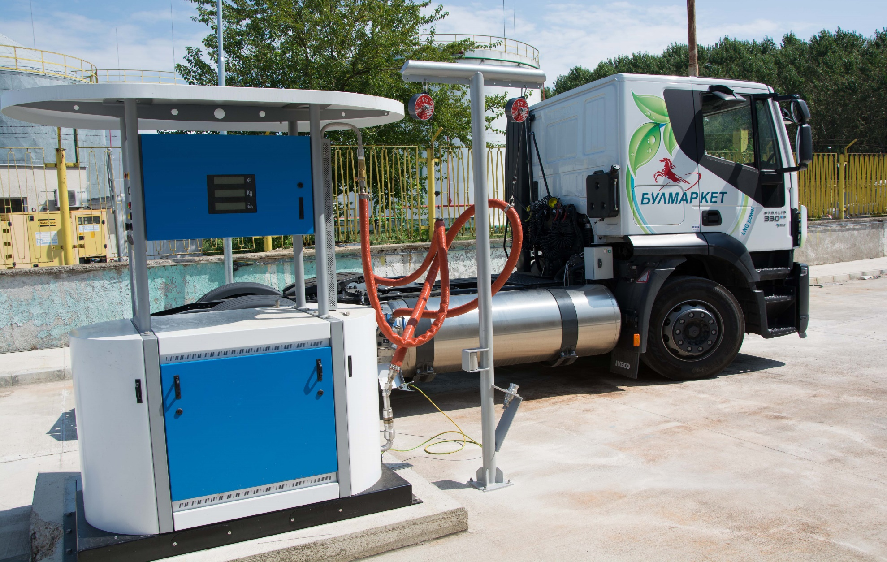
Bulmarket LNG

Slide 25
BULMARKET GROUP PERSONNEL MANAGMENT
Permanent growth
Experience & depth
- Leadership from 4 nationalities
- Diverse talent management of over 850 personnel
- Young and dynamic workforce with average age of 39 years
- Project & Operations experience for over 20 years

Slide 26
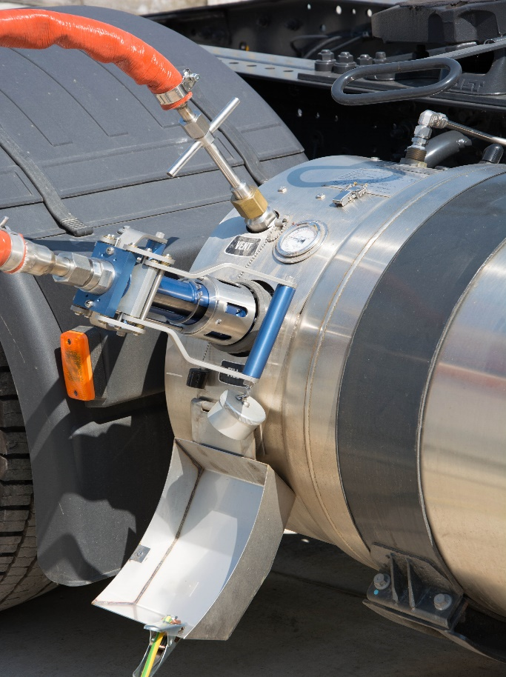
BULMARKET DM Ltd.
BULMARKET DM Ltd.
100 Tutrakan Blvd.
Ruse 7000, Bulgaria
Tel: +359 82 817400
Fax: +359 82 844862
Email: office@bulmarket.bg
Web: www.bulmarket.bg

