Slide 1
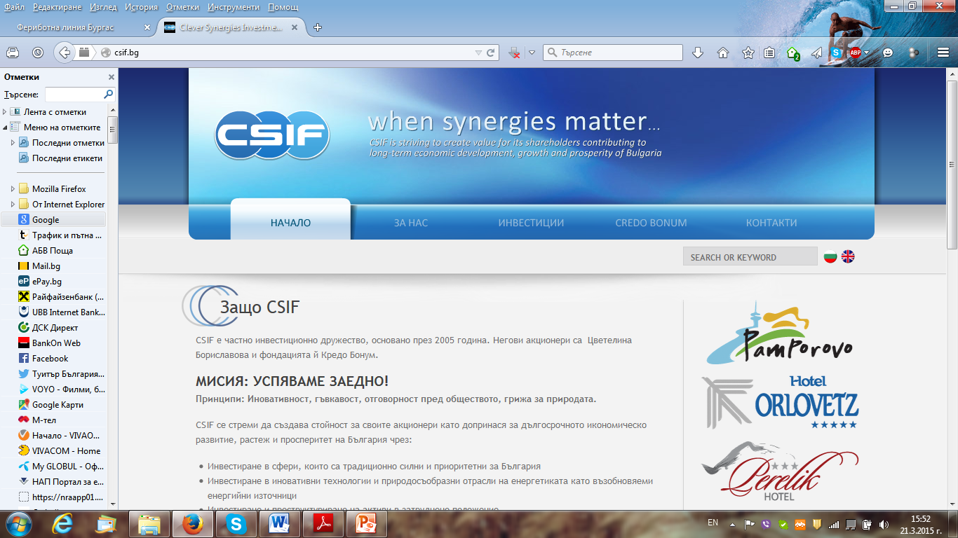
Clever Synergies Investment Fund
When synergies matter…

Slide 2
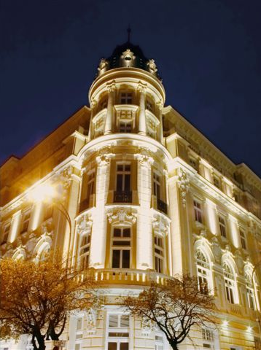
CSIF is among the largest companies in Bulgaria controlling assets of EUR 400 million
CSIF AD is a private investment company, owned by Tzvetelina Borislavova (99%) and her foundation Credo Bonum (1%).
It was established in 2005.
The company’s consolidated assets are over EUR 400 million, the capital is EUR 70 million and revenues reaching EUR 25 million per year.
It is focused on six main business areas:
  Freight forwarding and port services, Bulgarian Black Sea Transport-Logistics Center (BBSTLC);
  Tourism;
  Renewable energy;
  Engineering;
  Agriculture;
  Real Estate
CSIF has two major approaches in the investment process:
  Development of innovative projects
  Acquisition and restructuring of distressed companies
Our success and magnitude are based on a clear combination of a number of competitive advantages – those of Bulgaria, ours and those of our partners

Slide 3
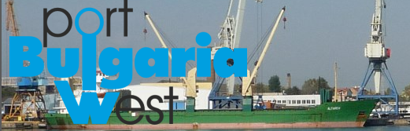
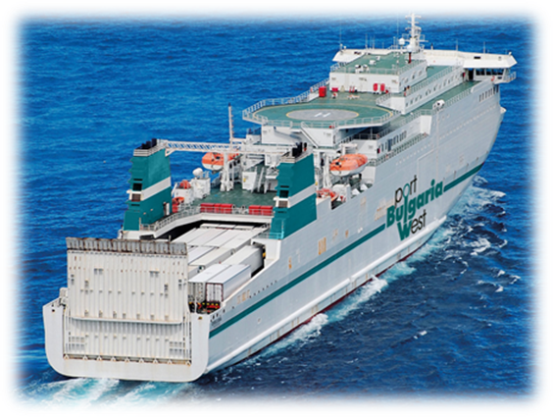
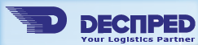
RORO Pax Drujba
Bulgarian Black Sea Transport-Logistics Center

Slide 4
Bulgarian Black Sea Transport and Logistics Center
(BBSTLC)
The BBSTLC is part of the Freight forwarding and port services of the holding CSIF
Involves Port Bulgaria West, RoPax Terminal and all facilities of Despred
  Despred – a leading Bulgarian company, offering all types of handling and transportation of goods as well as customs clearance for import and export
  Port Bulgaria West - a public transport port, refrigeration warehouses, fish processing factory, situated in the South-East part of the Bay of Bourgas
  RoPax Drujba – is 190 meters long. Capacity : 123 cabins (75x4 beds, 40x2 beds, 8x2 beds VIP)
  - 550 passengers;
  - 110 trucks;
  - 90 cars
  RoPax Terminal
4

Slide 5
BBSTLC is aiming to revive the traditional for Bulgaria economic activities in the field of industry, agriculture, transport and tourism.
The strategic geographical location of Bulgaria makes it a suitable meeting point on the silk road.
Five pan-European transport corridors pass through the country, allowing your cargo to reach markets with over 500 million users.
TRACECA (Transport Corridor Europe – Caucasus - Asia) connects Bulgaria with Central Asia.
  We Offer:
  • a reliable partnership with the holding company /CSIF/. As a result of the high reputation in addition to the excellent relationships with both our partners and the public administration, CSIF becomes a guarantor for the successful realization of your projects.
  • the developed and functioning structure entirely privately owned and maintained via Bulgarian capitals enables flexible management solutions tailored to your needs and priorities.
  • proficiency and quality in the handling and delivery of goods , fostered for more than 65 years

Slide 6
Despred Plc is a leading Bulgarian forwarding company established in 1947. Our long standing experience in the logistic services gives the confidence to meet every new challenge and project.
Our unique structure gives allows to provide high level services with all kind of transport. Despred is presented with its own offices at the main sea, river and air ports of Bulgaria, border points with Republic of Serbia and Republic of Turkey, as well as in the biggest Bulgarian cities – Sofia and Plovdiv.
Despred Plc owns and operates three main terminals- Sofia, Bourgas and Dimitrovgrad and possesses with another……own terminals throughout Bulgaria.

Slide 7
Investing in functional technology and modern facilities for container operation as loads shacking/scanning, we provide all the procedures for container treatment from the biggest container lines, working with Port Bulgaria West Plc. We are providing also additional services as containerization/ de containerization, not only at the port but in the container depot of Despred Plc in the terminal in Dolno Ezerovo.
Using one information platform, we offer you complete, entire solution with optimum price rates and transit time.

Slide 8

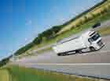
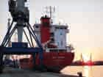
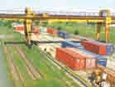
DESPRED Main Terminals
Sofia city /head office/ - 36 000 sq. m.
✓Warehouse situated in Sofia city, near by customs, main bus station and rail station
✓Covered area – 6 000 sq. m. /bonded, temporary, free storage/
✓Open area /TIR parking, depot/
✓Transshipment truck/container (lcl and fcl)
✓Weekly groupage lines from EU, door to door deliveries
Branch Bourgas – 101 000 sq. m.
✓Warehouse situated in Bourgas city, Dolno Ezerovo, 15km from port Bourgas, 12km from highway
✓Covered area – 6 000 sq. m. /bonded, temporary, free storage/
✓Open area /TIR parking, container depot/, transshsipment truck/container/
wagon
Branch Dimitrovgrad – 22 000 sq. m.
✓Warehouse situated in Dimitrovgrad, 200m from cargo rail station- dispenser, 30km from highway
✓Covered area – 3 000 sq. m.
✓Open area /TIR parking, depot/ , transshsipment truck/container/
wagon

Slide 9
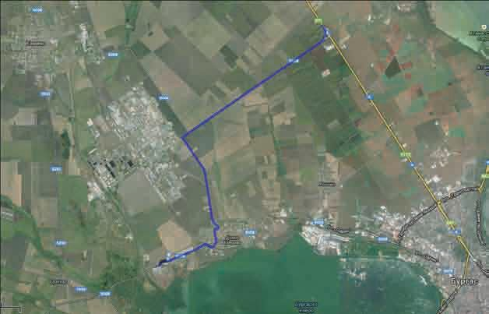

BOURGAS location
12 km. from the highway

Slide 10

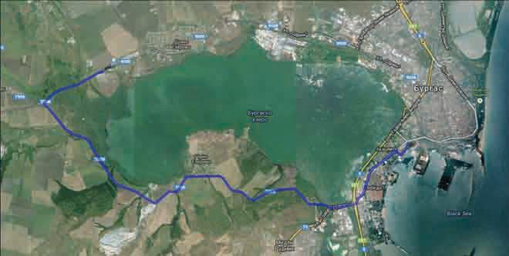

BOURGAS location
15 km. from port Bourgas
Port Bulgaria West

Slide 11
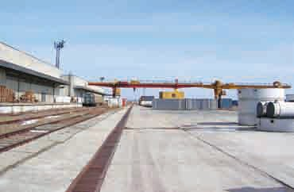
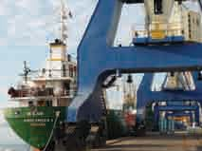


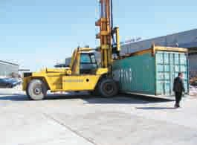

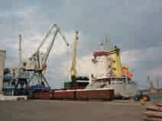


BOURGAS location
Two portal cranes – 32 t; 12 t Open area / container depot over 4000 TEU Own rail trace
Reachstacker 32 t Truck scale up to 60 t

Slide 12

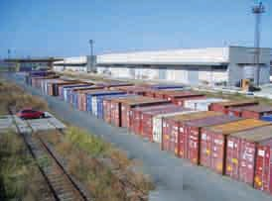

BOURGAS facilities
✓Up to 15 km from ‘port Bourgas’
✓Up to 6 km from ‘cargo rail station-dispenser’
✓Covered storage area - 6000 square meters
✓Open area/container depot over 4000 TEU
✓Total area – 101 000 square meters
✓Operates with Customs points BG 1000 and BG 1007
✓Own 2 gantry cranes with loading capacity up to 32 t. and up to 10 t.
✓Own 4 electric hoists with loading capacity up to 4,5 t. in covered warehouse area
✓Own railway tracks with total length 3000 m.
✓4 own forklifts with loading capacity up to 3,5 t.
✓2 own rail-cranes
✓2 own electric forklifts - up to 2.5 t.
✓Own truck scales up to 60 t.
✓Temporary, bonded and free storage
✓Security & fire systems
✓Non-stop armed guard

Slide 13

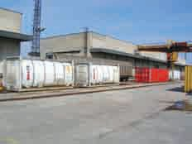
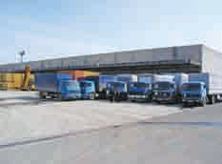
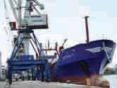


BOURGAS facilities
✓Railwayhandling, stationformalitiesanddocumentation
✓Sea port handling, port formalities and documentation
✓Multimodal transports (rail, road, air, sea)
✓Customs service and agency
✓Container transports – import and export
✓Carriage of bulk cargoes via port Bourgas to/from any appropriate port in the world
✓Transit operations with bank guarantee for any goods on the territory of BG and EU
✓Full terminal service with availability of:
◆
trans-shipment operations wagon/truck/
container with specific own equipment
◆
warehousing of conventional, excise and
specific goods, and warehouse management
◆
shipments packing, palletize, labeling inland transport and distribution
◆

Slide 14

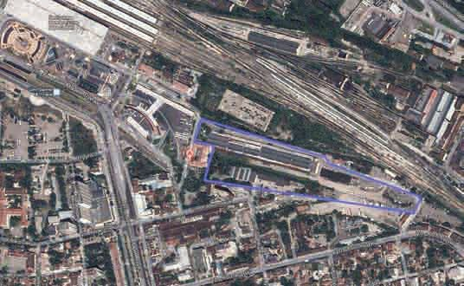

SOFIA location
Customs
Near by Customs Sofia BG005800 excellent road connections

Slide 15


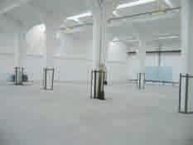

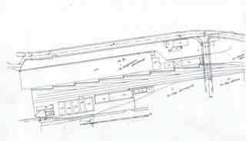
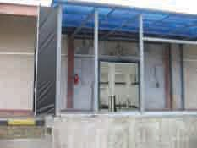

SOFIA location
Located in the city of Sofia, next to Customs Sofia BG005800
✓partial and full loads (ltl, ftl, lcl, tcl)
✓distribution and consolidation /door to door/
✓transshipment container / truck / store
✓Total area of 36 584 square meters
✓Covered storage areas – 9 400 square meters
✓Temporary and bonded warehousing, free storage

Slide 16

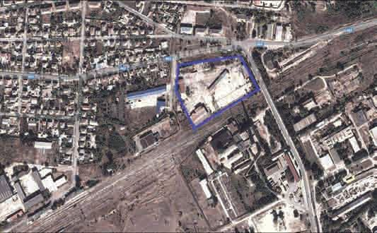


DIMITROVGRAD location
32 km. from highway Bourgas-Sofia
12 km from
E80 Istanbul-Sofia

Slide 17


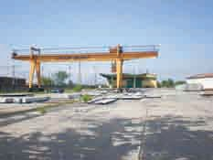

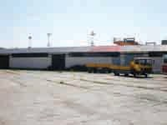
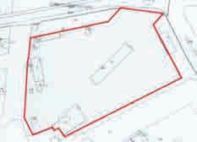

DIMITROVGRAD facilities
Container terminal with an excellent road connection at a distance of:
◆
12 km from E80 ‘Istanbul-Sofia’
32 km. from Highway ‘Bourgas-Sofia’
200 km. from Sofia (the capital) and Bourgas
◆
◆
(sea border of EU)
◆
Near by rail station “Dimitrovgrad-North
✓22 700 sq.m. Inland roads and rail trace
✓8 440 sq.m. concrete platform
✓540 sq.m. workshop-platform parking area
✓32 t portal crane
10

Slide 18
Port Bulgaria West Plc is founded in 1999г. . It is fully integrated with the national transport infrastructure.Possesses an internal rail network serving each ship berth and several way connections leading to the main roads and city ring road of Bourgas. The port gives a real opportunity for short and secure continuation of logistic schemes and transport corridors through the Black Sea.
CSIF owns one of the biggest refrigeration base on the Balkans, which enables warehousing of frozen and well cooled products and a fish processing enterprise, situated at Port Bulgaria West Plc,
The port holds its own licensed laboratory for food cerification.
The availability of our own neighboring internal terminals, gives us more possibilities to handle bigger lots, requiring more warehouse space, without blocking the main functions of the port. Goods are dispatched to the port, with preliminary prepared documents.

Slide 19

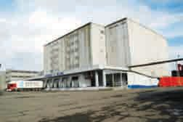

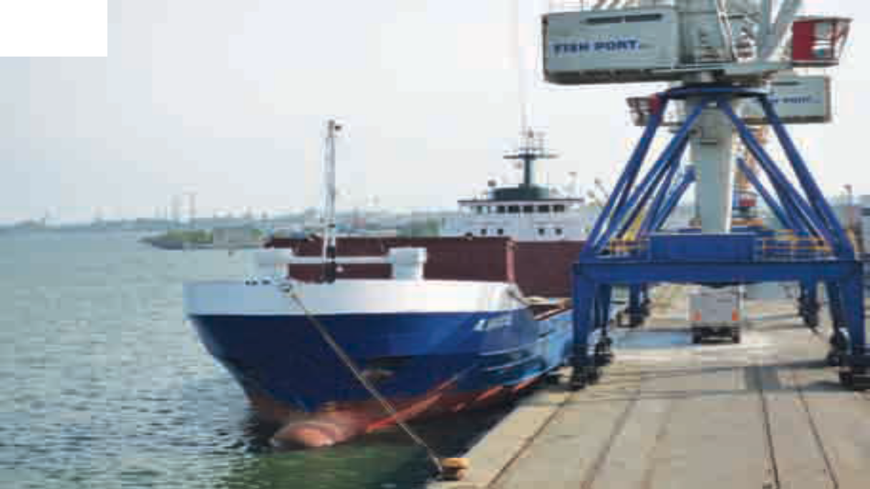
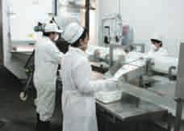

Port Bulgaria West

Slide 20

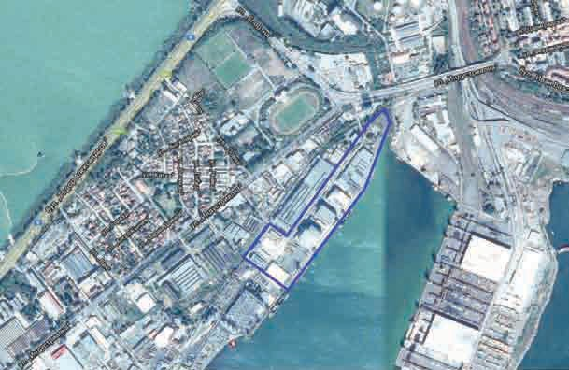

Location
15 km. from terminal Despred

Slide 21

Port Bulgaria West -Company overview
✓Public Limited Company manages a specialized port in the South-East part of the Bay of Bourgas.
✓Fully integrated with the National Transportation System. Own rail network serves every berth and road links leads to all parts of Bulgaria.
✓Five port cranes are available as well as open and covered sites with a total area of 12 acres.
-1 mobile crane with 100 t capacity
- 2 cranes with 12 t capacity
- 2 cranes with 6 t capacity
✓Port equipment, qualified staff and stevedores.
✓The port is licensed by the Bulgarian Customs' Authorities as a Duty Free Zone - a great advantage for all kind of transit cargo business.
✓PBW processes over 200,000 tons per year with a predominant cargo of : citrus fruits, non-ferrous metals and steel, liquid non-petroleum products, chipboards, plaster products, palletized cargo, bulk cargo.
✓The port is open and under security supervision 24/7 which ensures our clients protection.

Slide 22

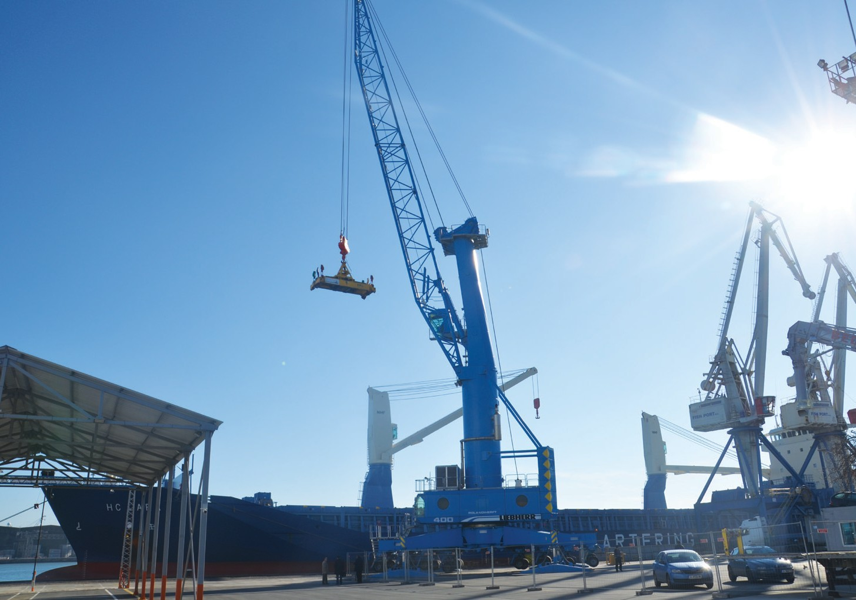
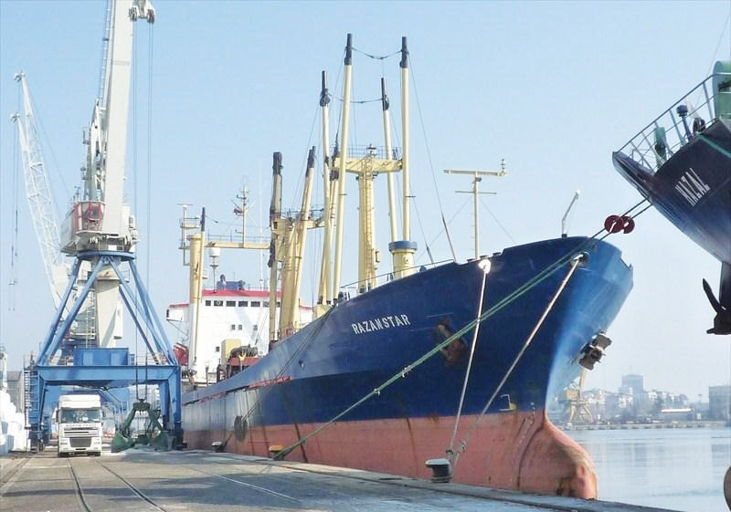
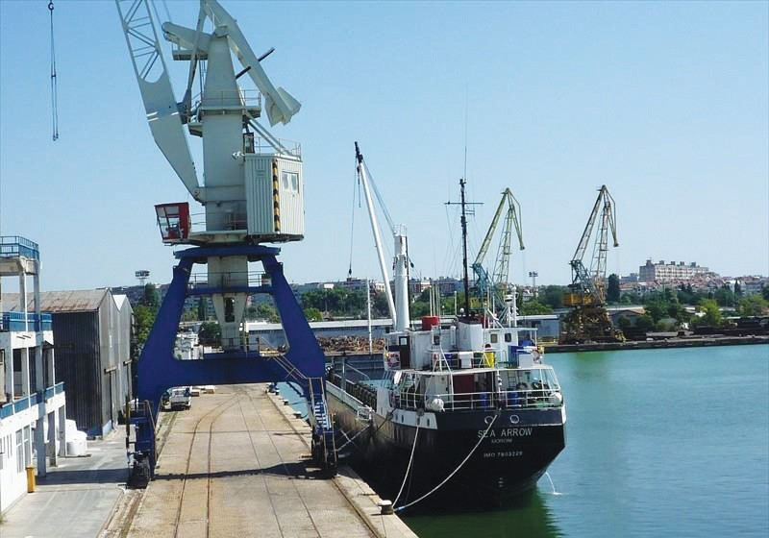
Facilities
The Port disposes of 4 berthing places:
✓1st berth place - draught of 6,00 m;
✓2nd berth place - draught of 7,50 m;
✓3rd berth place - draught of 8,50 m;
✓4th berth place - draught of 5,00 m.
Five port cranes :
1 mobile crane with 100t capacity
2 cranes with 12t capacity
2 cranes with 6t capacity

Slide 23

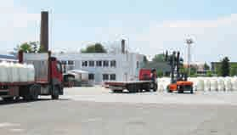
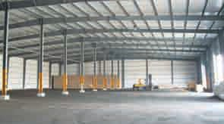

Facilities
✓Open and covered sites with a total area of 12 acres.
✓The covered sites consist of:
✓Massive four storey warehouse allowing the release of cargo by type and quantity, built on an area of 1500 m2;
✓Metal two storey warehouse with an area of 1000 m2;
✓Covered warehouse with an area of 2700 m2.
The territory of the PORT is licensed by the Bulgarian Customs' Authority as a Duty Free Zone that is a great advantage for all kinds of transit cargo business.

Slide 24



The largest Refrigiration base on the Balkans
✓The company Buljac PLC is the refrigeration base of Port Bulgaria West .
✓It has implemented integral Quality Management System in compliance with ISO 9001:2008 standard and System for Food Safety Control, not only for the freezing/ conservation warehouse operations, but for the fish processing as well.
✓The freezing/conservation base is approved by customs authorities for the provision of temporarily storage of foreign goods with current status "customs storage".
✓14 refrigeratory halls with total volume 48 000 sq.m. and temperature range +17 to -27 degrees Celsius.
✓Fully automated installation. Detectors and record devices allow tracing back the temperature deviations in each refrigeratory hall for 24 months period
✓Quayside area and cranes in close proximity to the freezing warehouse for direct loading and discharge operations /refrigeratory vessels /

Slide 25

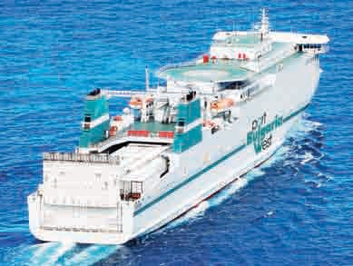

RO/Pax Ferry – Technical Details
Main characteristics of Ro-Pax Drujba
IMO 9237242
GT 25028
LOA 180 m
BEAM 24,3 m
DEPT 9,6 m
DUP Deck 15,3 m
Access to garage – a door / Main ramp 17,50 m long / 18,20 m wide
/ 5,20 m height – SWL 90 t
Freight Capacity
1900 LM ( deck 5 – 1070 m with 8
strips for loading/ deck 3 – 830 m with 6 strips for loading)
Free high 4.90 m
Load Capacity:
Equably distributed load – 3 t/m²
Axel load – 18 t (2 axels with 2 tires and 1.3 m distance between the axels)
Loading area - 1900 lane meter 110 trucks/ 140 trailers + 88 cars Passenger capacity - 550

Slide 26

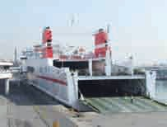
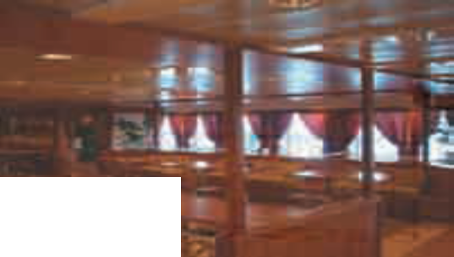


Max weight of trailer – 45 t (with 4 tires)
2 Mobile ramps connecting Deck 3 with Deck 5
Maximum weight of unit – 2 t Axel load – 1 t.
2 Fixed ramps connecting Deck 1and Deck 2
18
Length 52 m
Width 3.20 m
Height 4.70 m
SWL 170 t
Width 3.10 m
Height 2.45 m
Passenger Capacity and Accommodations
Cabins with beds (total bed 396)
75 x 4 beds (2 cabins adapted for disable people)
Car Decks
396 LM (car deck 1 – 216 m / car
deck 2 – 180 m ) Free high 2.20 m
Average weight of unit – 1 t
152 persons on Deck 8
✓Bar Cafeteria “Mediterraneo”
with seats for 96 persons
on Deck 8
✓Bar Cafeteria “Club de
Conductores” with seats for 108
persons on Deck 8
✓Public Toilets (one adapted for
disabled people)
✓Hospital on Deck 9
✓Lift passenger – 2 (capacity 10
persons / 75 kg / 750 kg)
40 x 2 beds
8 x 2 beds – VIP
Reception/Information centre on Deck 7
✓Shop on Deck 8
✓Self service “Los Patios” for
148 persons on Deck 8
✓Bar Lounge “El Corsario” with
on Deck 8
✓Lounge with reclining seats for

Slide 27

Burgas RoPax Terminal Plan

Slide 28

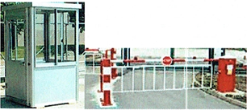
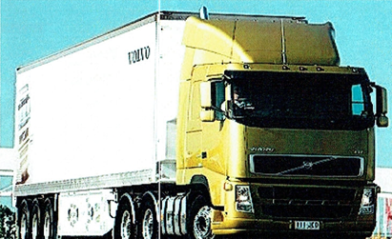
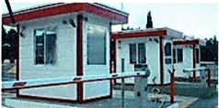


Slide 29
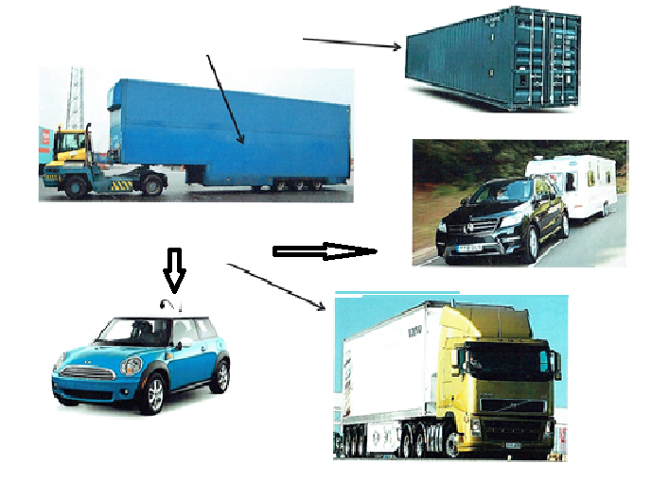

Unaccompained Traffic
Accompained Traffic

