Slide 1
South East Europe Co Modality 2016 Plovdiv, Bulgaria 1st & 2nd September 2016
Shortsea shipping

Slide 2
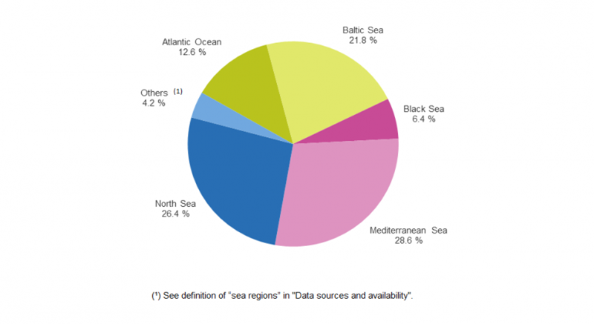
Short Sea Shipping in figures
Nearly 75% of EU’s external trade (imports and exports) and 37% of the internal trade, goes by sea.
(Analysis of recent trends in EU shipping and analysis and policy support to improve the competitiveness of short sea shipping in the EU – June 2015)
Short sea shipping made up 59 % of total maritime transport of goods to and from the main EU ports in 2014
Between the EU-28 main ports and ports located in the Mediterranean, SSS of goods accounted for about 29% of the total SSS tonnage declared, in 2014.
In comparison:
North Sea follows with 26%
Baltic Sea with 21%
(Source: Eurostat 2014)

Slide 3
EU recognition of the importance of SSS
SSS is considered as a strategic component of the transport system since it can provide an important contribution to smart, sustainable and inclusive growth in the EU (White Paper)
The Athens Declaration adopted in May 2014 by the Ministers responsible for the Maritime Transport of the European Union and the European Economic Area emphasized that
Short Sea Shipping needs to play a stronger role in the EU to ensure the necessary accessibility and trade flows, including between the mainland and islands, and to shift long-distance transport away from roads in order to address capacity, energy and climate challenges while noting, in this context, the goals defined in the White Paper on transport policy published by the Commission in 2012 ; RECOGNISING the important role of the European Shortsea Network (ESN) and its members Shortsea Promotion Centres (SPCs) to that regard;

Slide 4
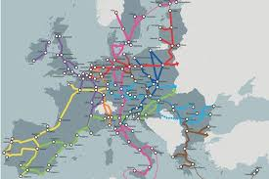
SSS as an alternative mode of transport
Shifting freight from European roads to the sea could:
Relieve congested road networks
Improve the competitiveness of the EU economy.
Have a positive environmental impact
SSS can offer:
Greater economies of scale in relation to the
road-haulage
Higher capacity to absorb demand
Through intermodal links, more supply chains
available to the shippers
Safer transportation of goods
Environmentally friendly, timely and cost effective transport mode
It is not a competitor of other modes of cargo transport;
it complements the other modes in order to achieve a successful intermodal transportation of goods and meet the economic and environmental objectives of the European union.
Cooperation with other transport modes with main objective in achieving quality of overland links with the interior

Slide 5
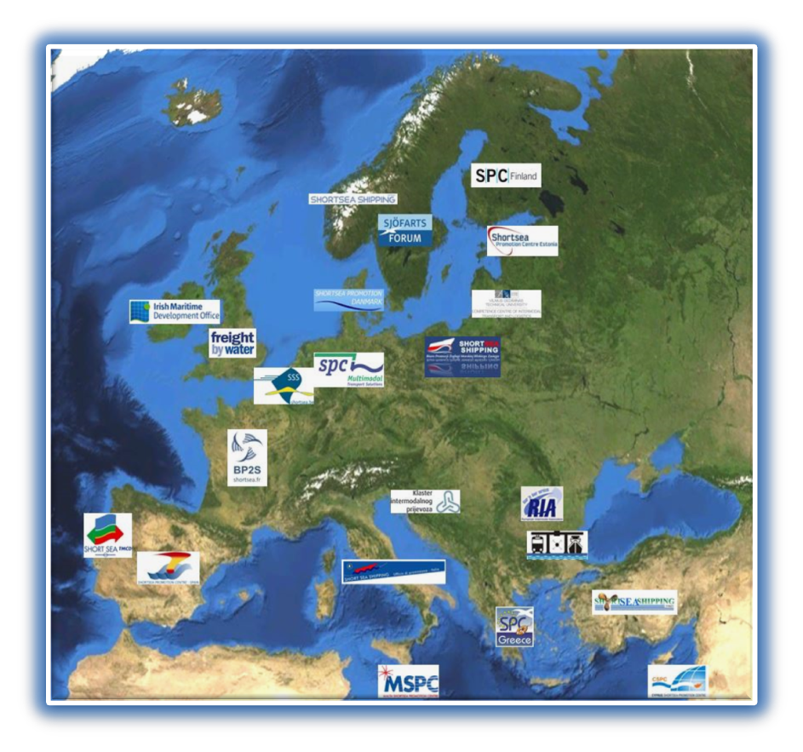
EUROPEAN SHORTSEA NETWORK
The European Commission in 1999,
created the SPCs with the objective to promote
SSS, at EU, national, regional and industry levels.
SPCs are driven by business interests
and offer neutral, impartial advice on the use
of SSS to meet the needs of transport users.
Work in line with the European promotion policy
in achieving a harmonious intermodal
transportation system.
The European Shortsea Network
offers a common, virtual tool for European promotion.
Mission:
to promote shortsea shipping on a European level, strengthening the activities of the national SPCs

Slide 6
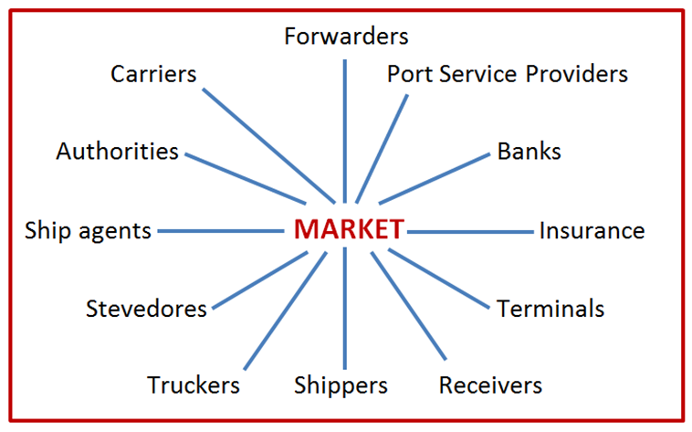
SHIFT 2020 project
New target:
SHIFT 2020 project:
A joint project with the European shortsea operators
and the other stakeholders.
SHIFT cargo from road to sea – a three year campaign
- identify cargo streams
- identify willing shippers
- propose alternatives through SSS
Defining new role of ESN- FACILITATOR – CATALYST
FACILITATOR:
To assist Commission to reach goal of shifting
at least 30% of road transport to SSS by 2030
HOW:
Understand the market –
Identify traffics which can have an economic
advantage if transported by sea
ECONOMIC ADVANTAGE:
Cheaper price
Transit time

Slide 7
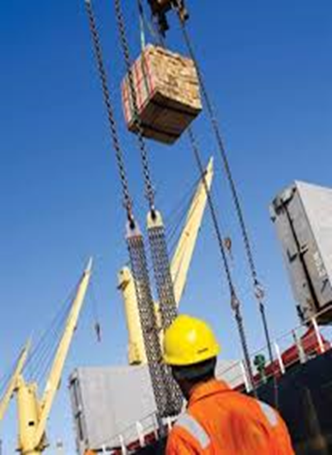
Essential features of SHIFT 2020
A pro-active approach both at ESN level and each SPC at national level.
Interaction with regulators/governments.
Address regulatory bottlenecks.
Acknowledge infrastructure limitations that hinder SSS.
Join forces with other stakeholders:
Shippers’ Councils, shipowners, port associations
Dissemination of data and information.
Formal reporting systems to update Commission.
Address environmental problems.
Join in discussion on application of new technology for SSS.
Education
Support initiatives of other service providers :
eg. Shipping agents, ship brokers

Slide 8
SHIFT 2020 project the portal
Where shippers meet shipping lines
A portal where shippers can search for services, share their requirements and select the best option
Best shortsea service for Transport Customers
More customers and cargo for Shipping Lines
Perfect Match
Cargoes ⬄ Services
A vital TOOL for....
finding best services for cargoes
finding new customers and cargo
shifting cargo from road to sea Way Forward
Search, Share, Select
Meet shippers ⇨ Find of cargo ⇨ Find alternatives ⇨ Match make

Slide 9
Obstacles in SSS operation
A number of obstacles hinder the optimal development of Short Sea Shipping:
It has not yet reached full integration in the door-to-door supply chain;
It involves complex administrative procedures;
It requires higher port efficiency and good hinterland accessibility
Ageing fleet – average age EU level 20 years
- of South Europe about 25 years
- in comparison DSS 14 years
European short sea fleets now gradually show a decrease.
New regulations that are coming into force.
Hellenic Shortsea Shipowners Association’s, initiative
(source: theguardian)
– the EUROPA SHIP Plan focused on the renewal of Short Sea Fleet of South Europe through this highly innovative project.
The Europa Venture( EV), a multi financing platform to serve the green compliance of EU Shortsea Shipping Sector
Similar SPV in the North Europe, the Zero Vision Tool.
More than 20 vessels are already included in a renewal plan while many vessels are already retrofitting in order to comply with the new regulations.

Slide 10
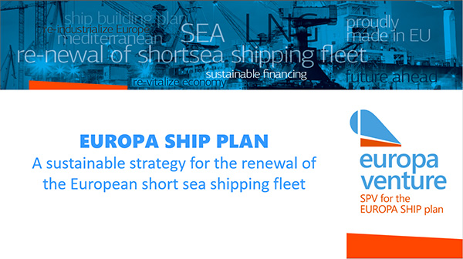
EUROPA SHIP Plan
What it is:
A financing tool
A plan for the renewal of the South Europe Shortsea fleet, by applying a financial blending mechanism, combining financing tools such as:
co-funding CEF/regional funds
financial instrument (Juncker Plan EIB lending/risk sharing mechanisms); and
traditional lending from commercial banks and funds.

Slide 11
EUROPA SHIP Plan
The concept;
Standardization of ship designs in order to apply economies of scale .
Can result to a significant CAPEX reduction up to 15% as compared to a traditional single order / single construction.
Additionally, by using dual fuel technology an OPEX reduction is feasible up to 20% compared to HFO scrubber alternative.
The aim is to create a cheaper vessel, able to comply with the future regulation; a vessel which will have a low carbon footprint in general.

Slide 12
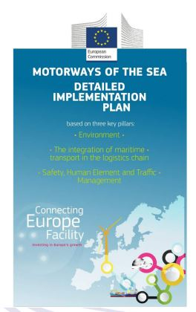
Detailed Implementation Plan
The Detailed Implementation Plan (DIP) has been built around
three thematic pillars that were identified by MoS Coordinator
Brian Simpson, in his 2015 Work Programme.
These are:
the Environment
the Integration of maritime transport in the global
logistics chain
Safety, Traffic Management and the Human Element.

Slide 13
EUROPA SHIP Plan & the ZVT are included in the Detailed Implementation Plan
“The ZVT and EV Europa Ship Plan (ESP) are joining forces towards this direction to facilitate the European Short Sea Shipping smooth adaptation. This is in line with what the stated industry needs are at present: a balance between CAPEX and OPEX, a risk sharing mechanism and some business cases to test the structure. In parallel the EIB, European Investment Bank, is introducing new product solutions. “
(source: DIP page 44)

Slide 14
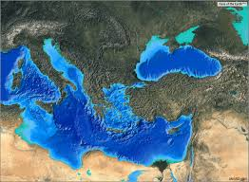
Join Forces
Our region has a lot to offer.
With greater co-operation at all levels, national level, private enterprises sectors, EU level and neighboring countries, we can increase economic cohesion, by identifying bottlenecks and provide common measures to resolve them in order to develop a safe, environmental, and financially viable for all stakeholders, sustainable intermodal transport system.

Slide 15
THANK YOU
Mary E.Pothitos
Advisor-International Relations
Hellenic Shortsea Shipowners Association.
Director
Shortsea Promotion Centre – Greece
Board Member of the European Shortsea Network
E-mail: m.pothitou@shortsea.gr
Mobile: +30 6944008980

