Slide 1
„Projects for Intermodal Terminals Managed by NRIC. Situation and Future Development”
NATIONAL RAILWAY INFRASTRUCTURE COMPANY
………………………………..
…………………………………
Plovdiv
September 2016
South East Europe Co Modality 2016

Slide 2
PERSPECTIVES FOR IMPLEMENTATION BY NRIC OF PROJECTS FOR CONSTRUCTION OF IMT
NRIC is Beneficiary under Operational Program “Transport” 2007-2013 and Operational Program “Transport and Transport Infrastructure” 2014-2020
Especially Beneficiary of Priority Axis 3 of OPTTI – improvement of intermodal transport services for passengers and freights and development of sustainable urban transport – which comprises projects for multimodality
Investment Priority 7 of EC - Supporting a multimodal Single European Transport Area by investing in the TEN-T
NRIC is the only State Manager of railway infrastructure by the Law
These conditions provide opportunities for financing from EFM projects for construction of multimodal terminals (included railway) and development multimodality
It gives a chance for direct funding by EU of railway and terminals’ basic and auxiliary infrastructure
The last is the NRIC key reason for managing implementation of projects for construction of intermodal terminals

Slide 3
KEY MOMENTS – NRIC AS A MANAGER OF PROJECTS FOR DEVELOPMENT OF MULTIMODALITY AND CONSTRUCTION OF IMT
The opportunities for direct funding by EU Funds under Operational Programs
The Administrative capacity for management of investment projects
Due to the Law* and Effectiveness NRIC may not be an Operator of the terminals, constructed under its management
Public Private Partnership for terminal operation
The Strategy is the Operator, independent private subject, to be pointed by an open, transparent and non-discriminatory procedure under Low of Concession
The Terminal will work in free and equal access basis to all licensed road and railway operators
The State will provide monitoring of the operation of the terminal and compliance with the market principle at provision of the services
The Procedure for concession is led by Ministry of Transport, Informational Technology and Communication
* The Law for Railway Transport

Slide 4
STRATEGY FOR DEVELOPMENT OF INTERMODAL TERMINALS
Strategy for integration of the Bulgarian railway infrastructure within the European network for intermodal transport was prepared in 2006 under the project funded by EU* - gave the main intermodal points for development:
Sofia
Plovdiv – South Central Region
Ruse – North Central Region
Black Sea Ports – Varna and Burgas
Other perspective points – Gorna Oryahovitsa, Dimitrovgrad, Lom (Vidin)
Actualization of the Strategy is planed - the updated Strategy will take into account:
The new economical conditions
The effect of the new constructed and put into service railway infrastructure in Bulgaria and SEE – IMT Plovdiv, the railway projects in Bulgaria, Dunau Bridge 2, tunnel under and new bridge over Bosphorus

Slide 5
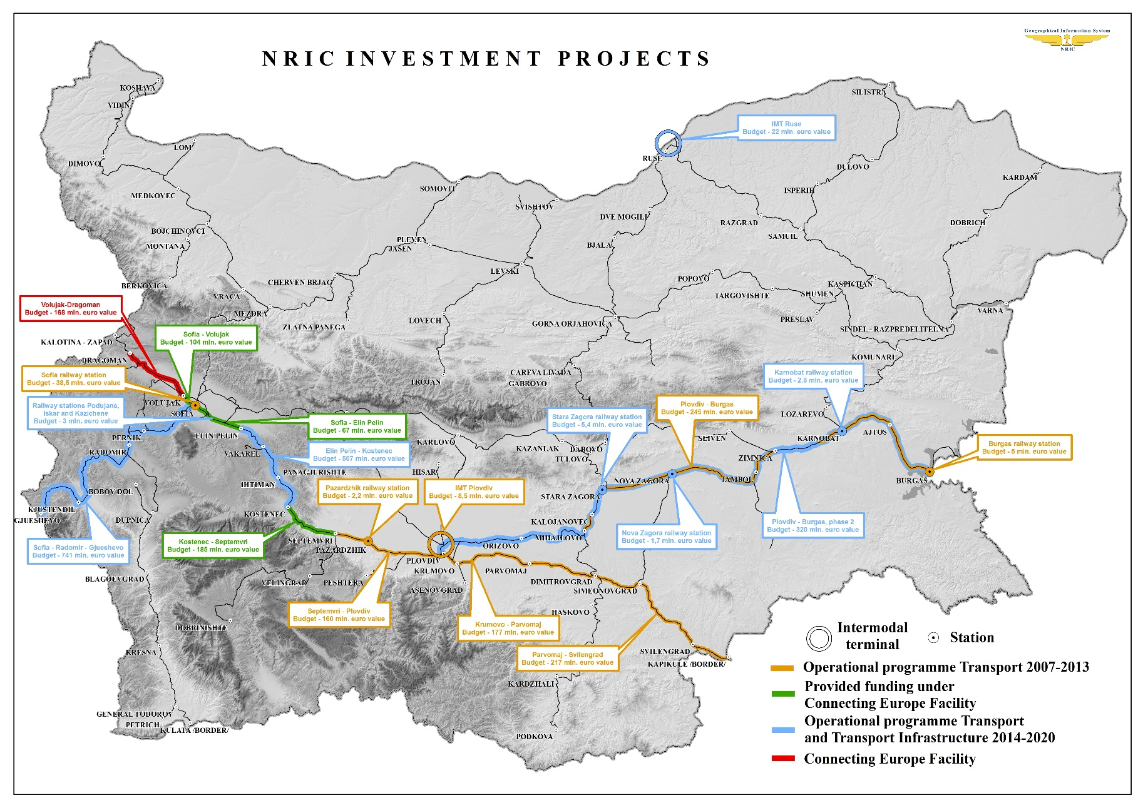

Slide 6
NRIC INVESTMENT PROJECTS
Operational Program “Transport” 2007-2013
Krumovo - Parvomaj – Svilengrad – Physical progress 98 %; 394 mln. Euro
Plovdiv – Burgas – Phase I - Physical progress 98 %; 245 mln. Euro
Septemvri – Plovdiv – Physical progress 86 %; 160 mln. Euro; Expected completion – November 2016
Operational Program “Transport and Transport Infrastructure” 2014-2020
Plovdiv – Burgas – Phase II - 320 mln. Euro
- Expected construction period – XI.2016 ÷ XII.2019
Elin Pelin – Ihtiman – Kostenets - 507 mln. Euro
- Expected construction period – 2017 ÷ 2020
Sofia – Radomir – Gyueshevo - 741 mln. Euro
- Expected construction period – 2018 ÷ 2022
Connecting European Facility
Sofia – Elin Pelin - 67 mln. Euro
Sofia – Voluyak – 104 mln. Euro
Kostenets – Septemvri - 185 mln. Euro
Expected construction period – 2017 ÷ 2020

Slide 7
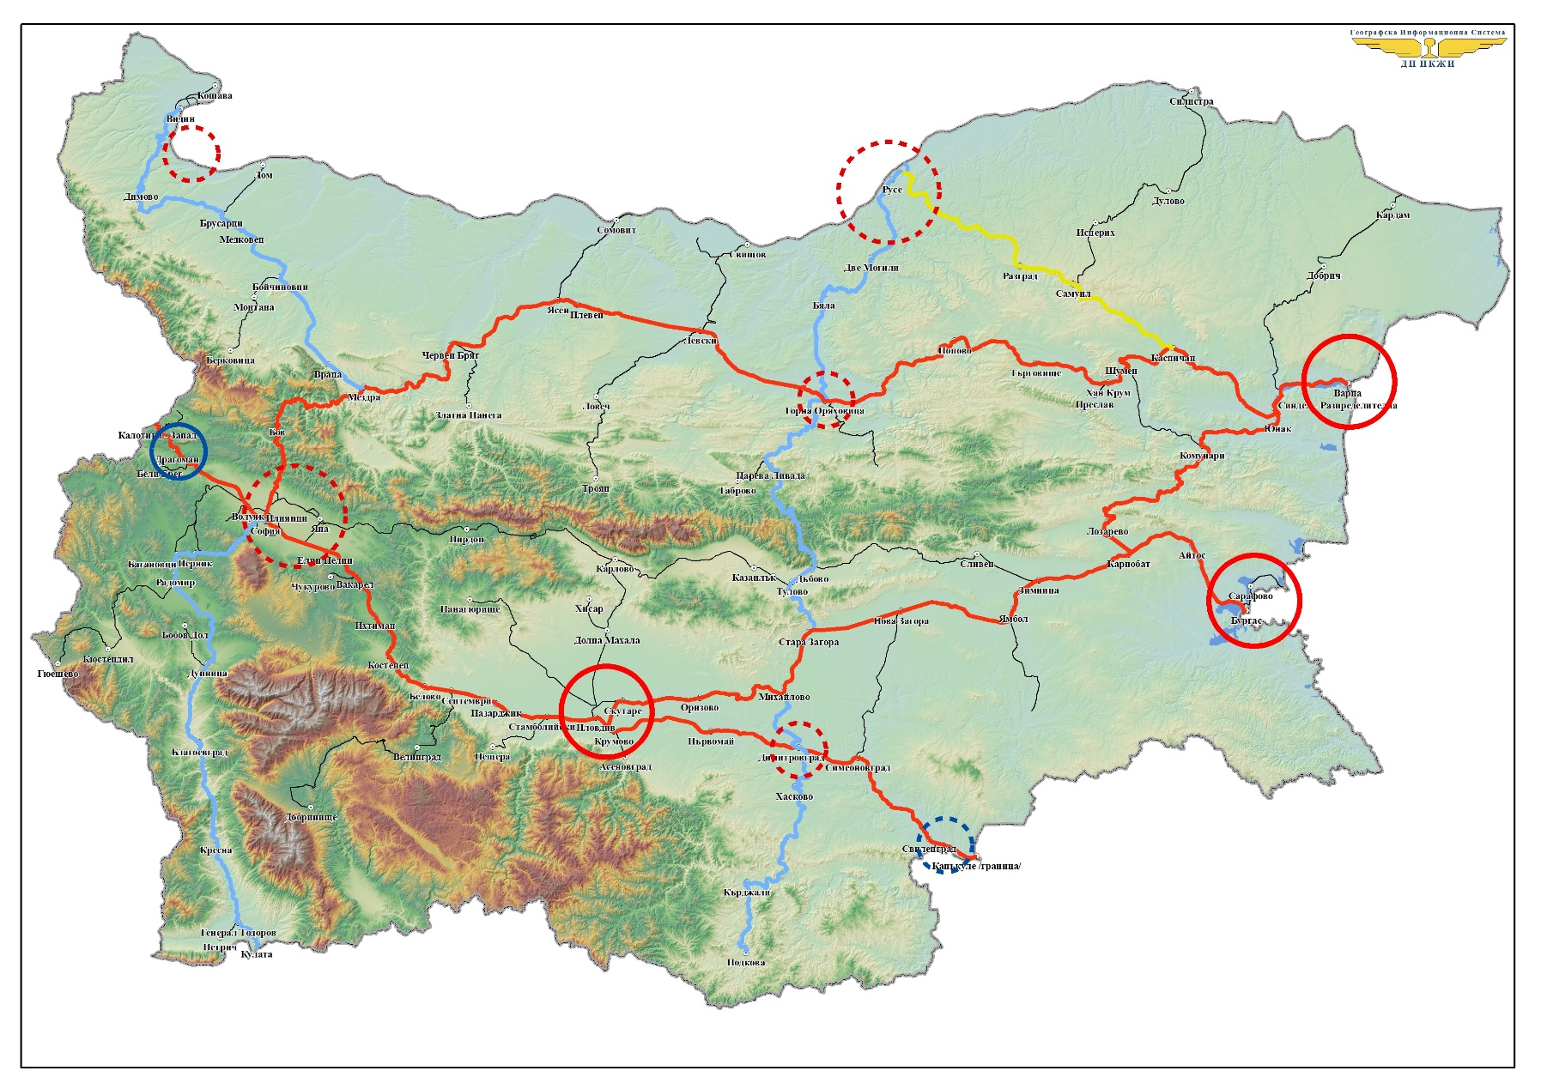
STRATEGY FOR DEVELOPMENT OF INTERMODAL TERMINALS

Slide 8
PROJECTS FOR INTERMODAL TERMINALS MANAGED BY NRIC
Intermodal Terminal in South Central Planning Region of Bulgaria – Plovdiv
Todor Kableshkov station – 8 km from Plovdiv
Sofia – Plovdiv railway
Now – Construction works is held on – the expected date of end of the construction works – October 2016
Intermodal Terminal in North Central Planning Region of Bulgaria - Ruse
Ruse–East–Dispatched Station – North Industrial Zone of the town
Approved General Plan, Conceptual Design and Parcel Plan. In Process for ensuring the financing
Main Project Characteristics
Building basic and auxiliary infrastructure of the terminal
Technical compliance of the new rail infrastructure with the specifications for interoperability, laid down in Directive 57 of 17 June 2008
Operation of the Terminal by independent Operator

Slide 9
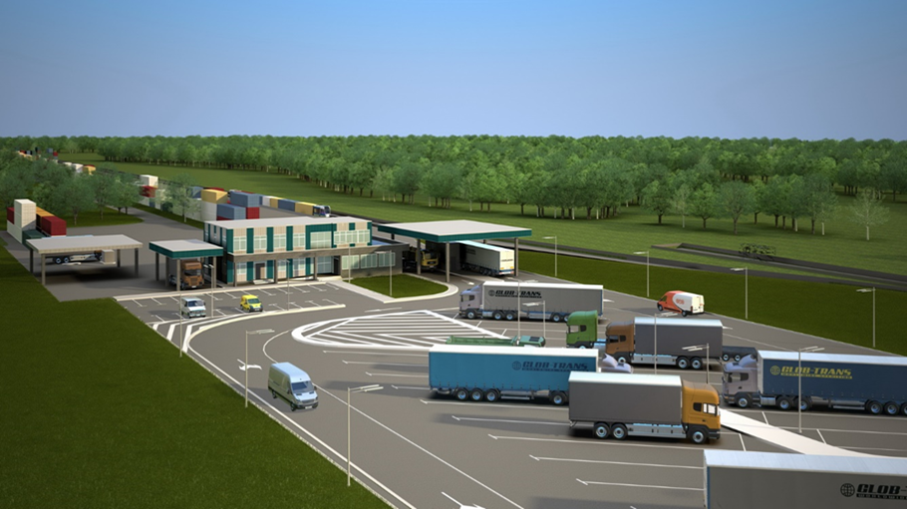
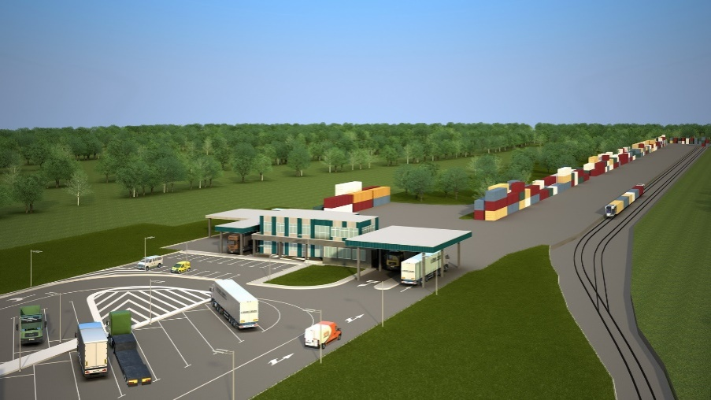
INTERMODAL TERMINAL IN SOUTH CENTRAL PLANNING REGION OF BULGARIA – PLOVDIV
Todor Kableshkov Station

Slide 10
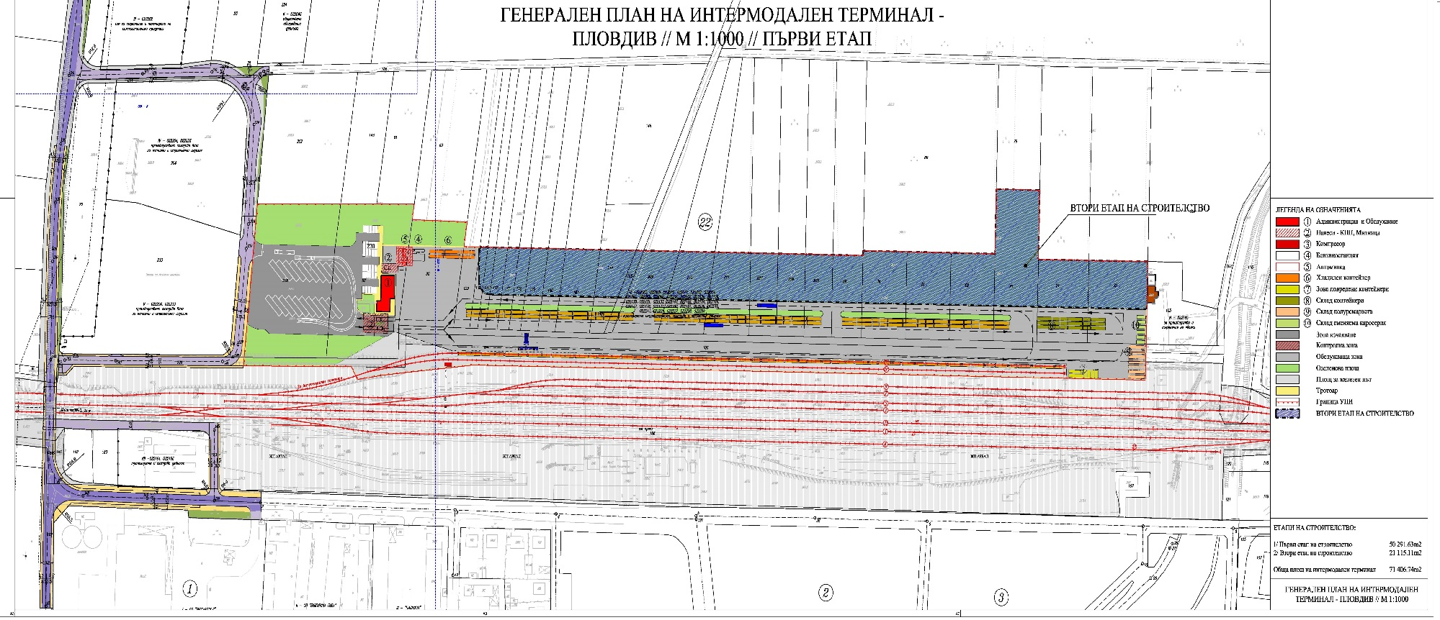
GENERAL PLAN OF INTERMODAL TERMINAL PLOVDIV

Slide 11
IMT PLOVDIV
Project: „Construction of Intermodal Terminal in South Central Planning Region of Bulgaria – Plovdiv“ – BG161PO004-3.0.01-0007
Finance: Operational Programme on “Transport” 2007-2013
The contract for granting financial assistance was sign with Management Authority in MTITC on 23.04.2014
Project Budget: 12 380 411,28 lv.
Eligible Expenditures: 10 322 531,77 lv.
Eligible for granting: 6 208 419,85 lv.
85 % or 5 277 156,87 lv. from EFRD
15 % or 931 262,98 lv. National co-financing
Eligible Expenditures, financing by NRIC: 4 114 111,92 lv.
Ineligible Expenditures: 2 057 879,51 lv.
Financial gap (deficit) – 60,14 %

Slide 12
MAIN TECHNICAL DATE
Area: 71 450 sq.m.
Location: village Zlatitrap, Rodopi Municipality, Todor Kableskov rail station (on main Sofia – Plovdiv railway)
Capacity:
57 600 TEU/year on I-st stage – one load-unload track
With perspectives for extension to 115 200 TEU/year – two load-unload tracks
Basic and Auxiliary Infrastructure
Working area (loading-unloading site) for operation and containers’ stock - with 520 х 60 m, with option for extension at future development
Railway infrastructure – a loading-unloading track with useful length of 520 m (26 shuttle), a shunting track and 3 arrival-departure tracks (on Todor Kableshkov station) – all electrified
Administrative building, Customs office, Technical buildings
Check point, parking for cars and trucks
Reconstructed Road PDV-1251 for LKW (heavy weight trucks) – 775 m and new road to the IMT – 225 m

Slide 13
WHAT’S GOING?
Expected end of the construction works: October 2016 г.
Moment status: 90 % physical construction
Terminal Operation:
Private Operator, pointed through procedure under Law of Concession
Operating of market principle with equal, non-discrimination access to all licensed auto and railway transport operators.
Concession Procedure:
Pointed of the Concessioner from MTITC by open and transparency procedure under Law of Concession.

Slide 14
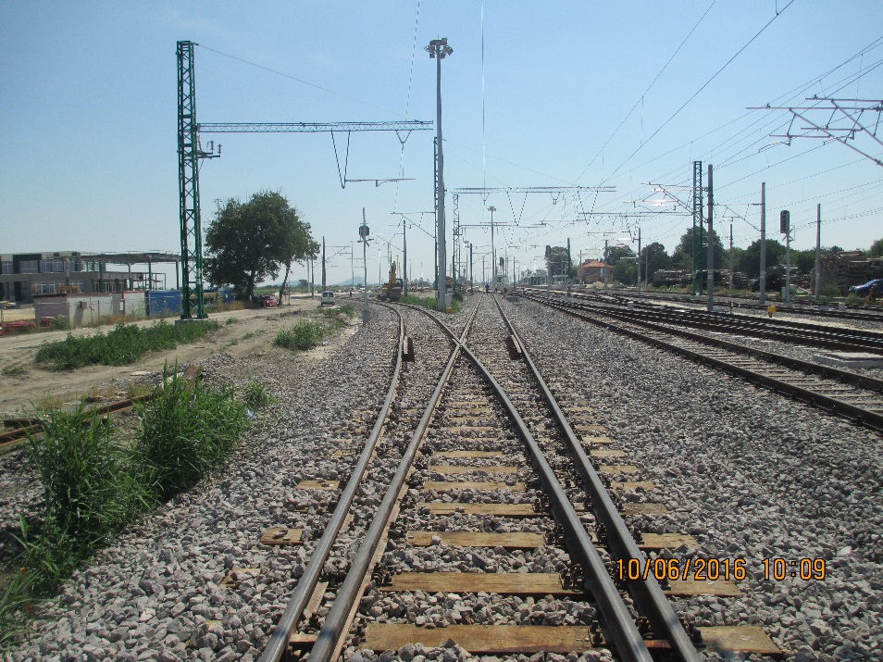
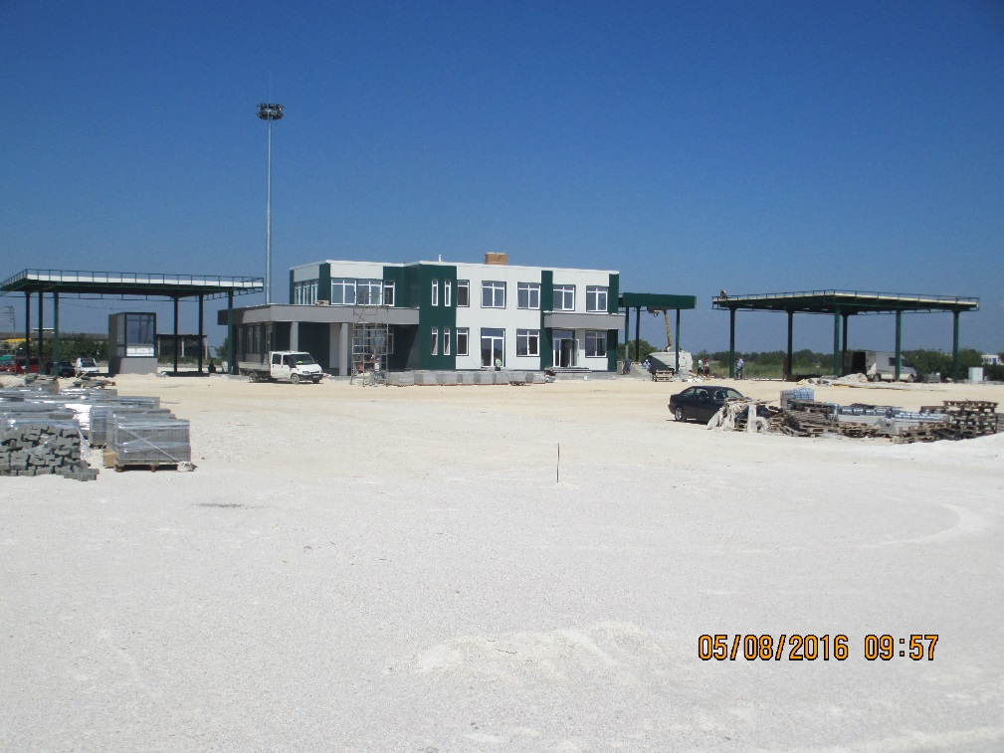
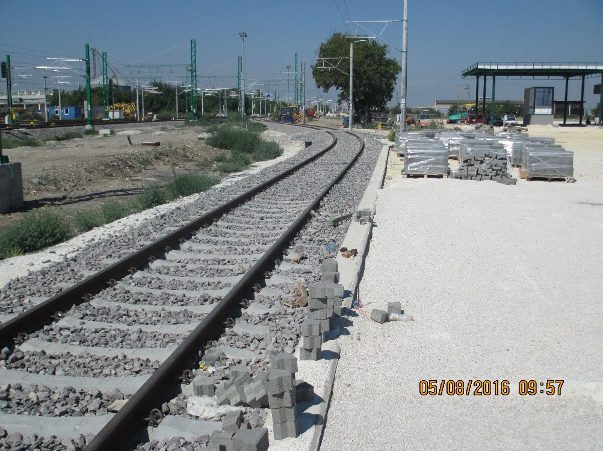
ACTUAL STATUS

Slide 15
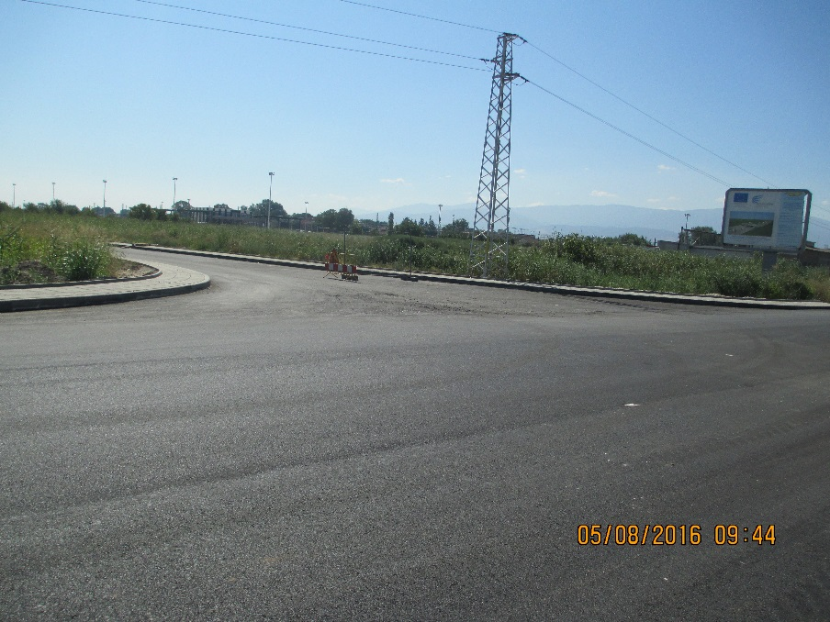
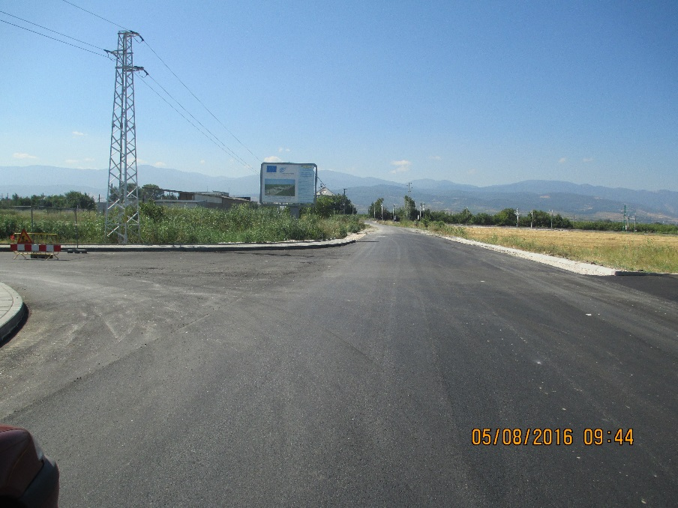
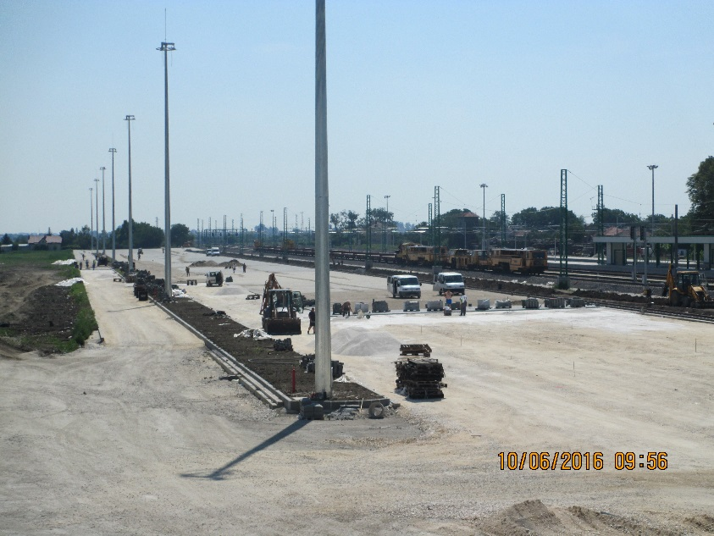
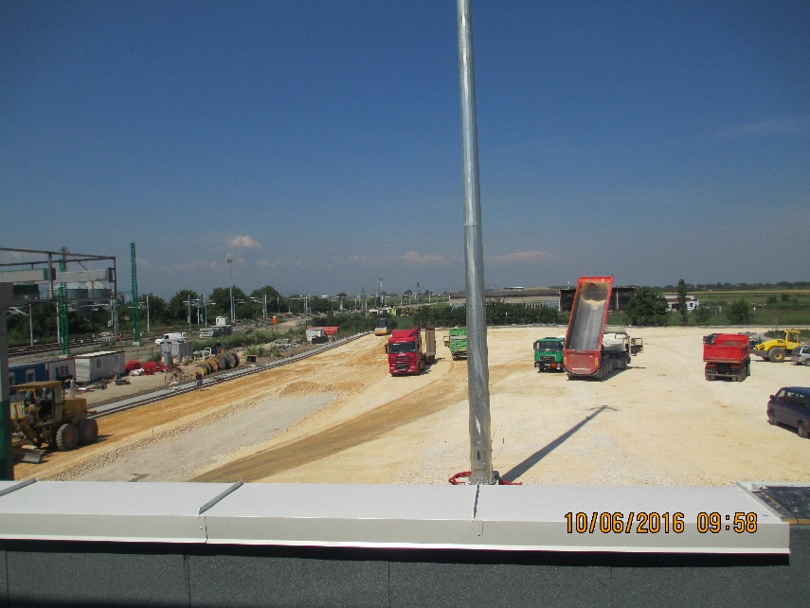
ACTUAL STATUS

Slide 16
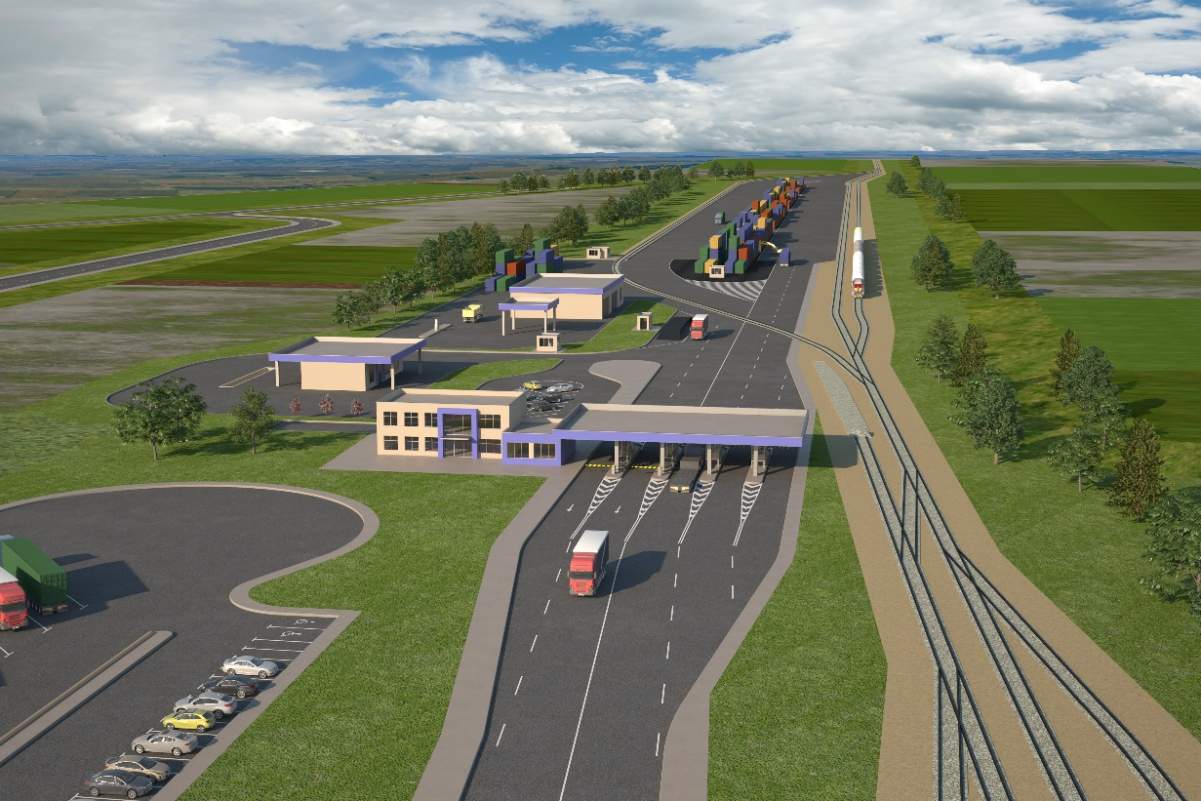
INTERMODAL TERMINAL IN NORTH CENTRAL PLANNING REGION OF BULGARIA - RUSE

Slide 17
PROJECT PREPARATION – TECHNICAL ASSISTANCE
Successful realization of Project for Technical assistance for preparation of Construction of IMT Ruse, financed under OP “Transport” 2007-2013 г.
Terminal site – on the terrain of former Ruse–East–Dispatch station
General Plan and Conceptual Design
Approved Detailed Development Plan
EIA and Archeological Procedures
Successful assessment of State Aid regime for funding of IMT Ruse construction under EU financing programs
Now on line is the process for ensuring the financing

Slide 18
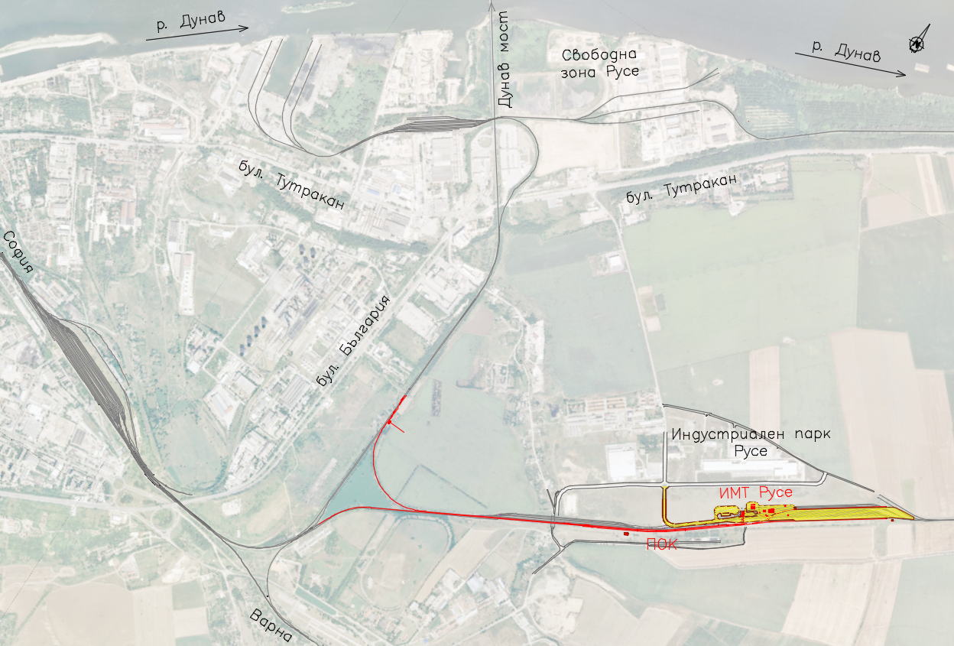
LOCATION
Direct access to all railway lines
Close to Industrial Park Ruse
Easy constructed road access
Optimal effectiveness of the expenditures
Fast connection to the ports, if needed

Slide 19
MAIN CHARACTERISTICS
Project: „Construction of Intermodal Terminal in North Central Planning Region of Bulgaria – Ruse”
Indicative Budget: 43 mln. lv.
Financing: Operational Program “Transport and Transport Infrastructure” 2014-2020
Main Technical Dates:
Capacity: 57 600 TEU/year - with perspectives for extension to 115 200 TEU/year
Loading-Unloading site for stocking and operation of the containers
New Station with 3 arrival-departure tracks for the operation of the terminal
Load-Unload track in the terminal with useful length of 540 m
Road access – from the North Industrial Zone
Administration building – for the administration of the terminal with offices for logistic and transport companies
Building of Customs Agency
Sites for refrigerated containers, for repair and maintenance

Slide 20
PROJECT TIMELINE
After Ensuring financing under OPTTI 2014-2020
Tender procedures for Constructor (engineering) and Construction Supervision and signing the contracts: 9 months
Technical Design: 6 months
Construction: 15 months
Terminal Operation:
Private Operator, pointed through procedure under Law of Concession
Operating of market principle with equal, non-discrimination access to all licensed auto and railway transport operators.
Concession Procedure:
Pointed of the Concessioner from MTITC by open and transparency procedure under Law of Concession.

Slide 21
PERSPECTIVES IN FRONT OF INTERMODAL TRANSPORT
Creating of condition for RO – LA
Construction of terminal in Svilengrad area
Rehabilitation of Dragoman terminal
Development of Intermodal Terminal Network in BG and integration within the European network for intermodal transport
Modernization of seaport terminals – Varna and Burgas
Construction of new intermodal points
Actualization of the Strategy for integration of the Bulgarian railway infrastructure within the European network for intermodal transport
Analysis of railway freight perspective of direction North – South in Bulgaria

Slide 22
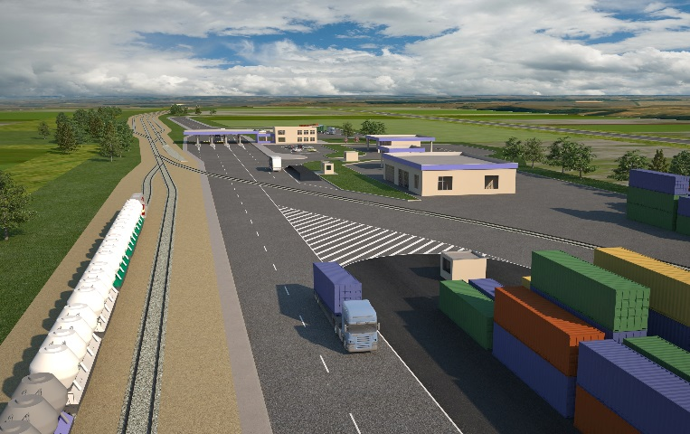
INTERMODAL TRANSPORT
NRIC supports any initiative, private or public, for construction an intermodal rail terminal and development of intermodal transport, which is directly related with development of railway infrastructure and transport and brings economic benefits to the state and society!

Slide 23
THANK YOU FOR YOUR ATTENTION!

