Slide 1
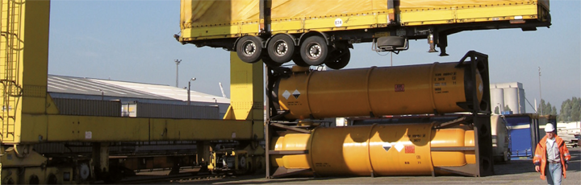
SEE Modal Shift – CoModality 2016 Conference
intermodal transport:
A european success story
Ralf-Charley SCHULTZE
President
Plovdiv
1

Slide 2
Contents
Introduction of UIRR, the industry association of Combined Transport
Properties of Combined Transport
The challenges of longer distance freight transport
The European solution to the problem
Intermodal freight transport to facilitate modal shift

Slide 3








UIRR - Overview
Members: Combined Transport Operators and Terminal Managers, who create the link between road and rail
Homogeneous interest of all members: modal shift from road to rail,
Logistics companies: customers as well as shareholders of UIRR Members
Performance: UIRR Members
handled about 50% of
European Combined
Transport in 2015
The Industry Association:
UIRR founded in 1970
- seat in Brussels since 1988

Slide 4
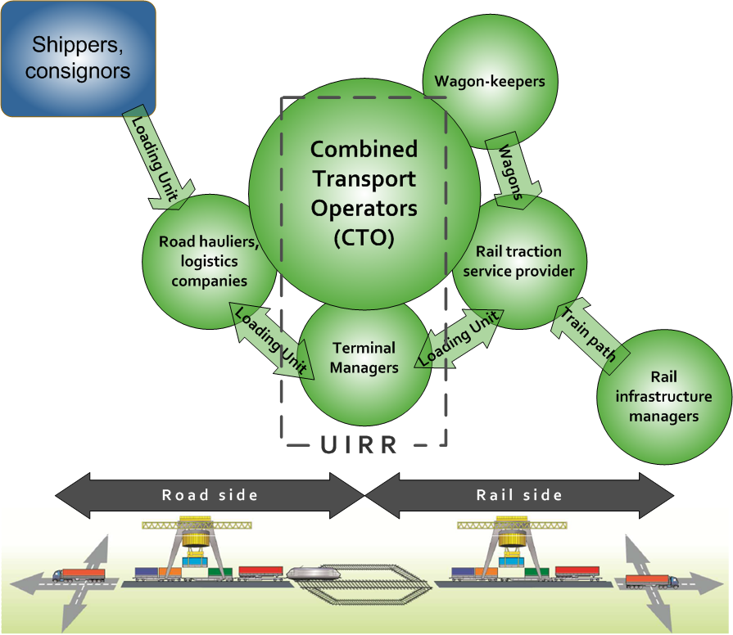
Position of UIRR Members within value-chain

Slide 5

UIRR - Mission
Grow the pie for Combined Transport
through fair competition on the basis of
technical merit
management competence

Slide 6
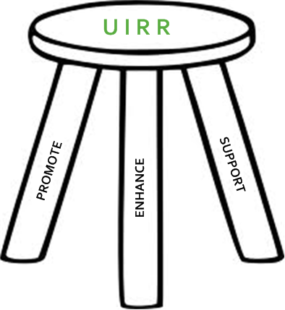
UIRR - Strategy
UIRR is an industry association which
PROMOTES the public understanding and appreciation of Road-Rail Combined Transport,
ENHANCES its development and the proliferation of industry best practice,
SUPPORTS the daily operation of European Combined Transport with a series of services

Slide 7
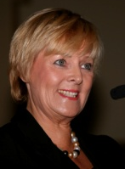
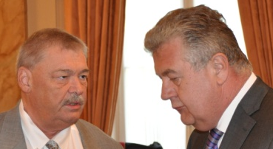
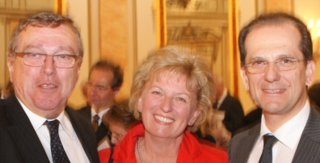
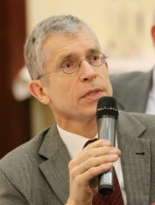
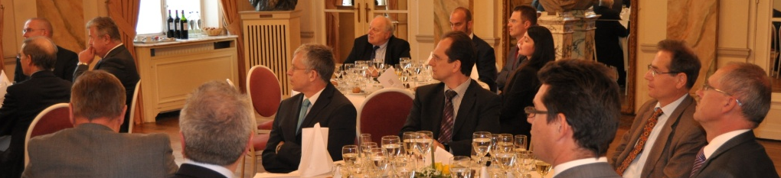
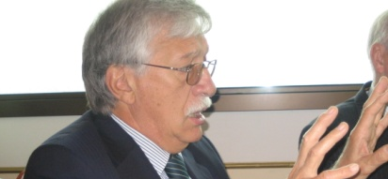
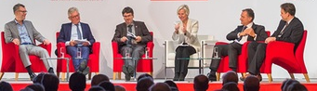
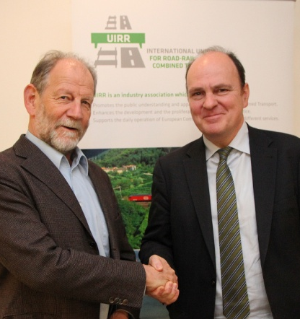
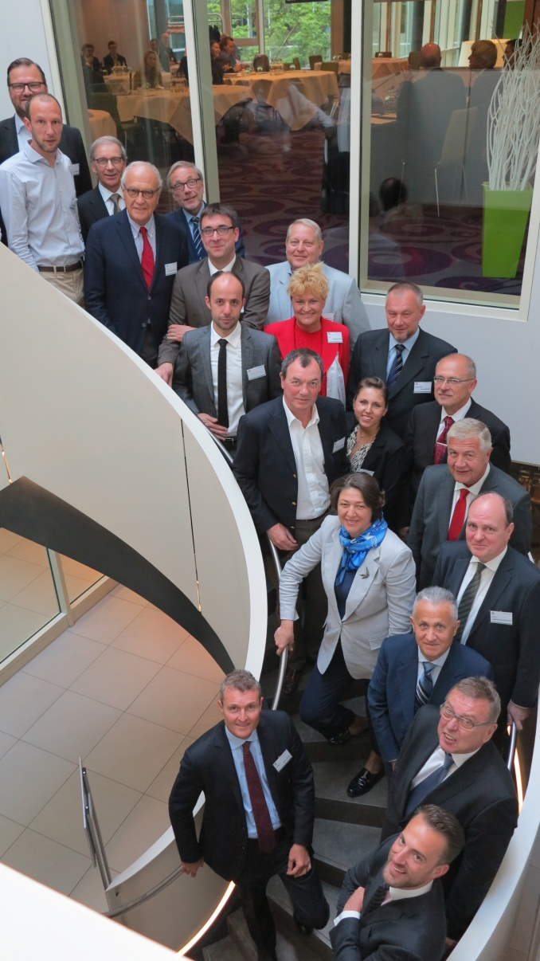
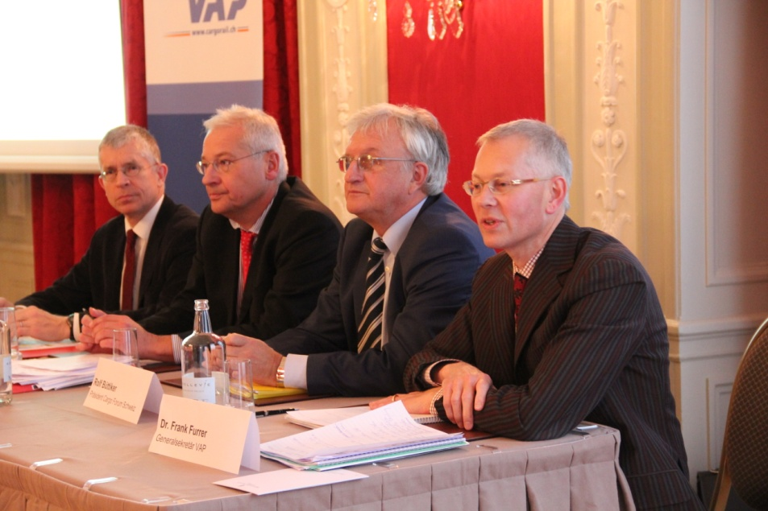
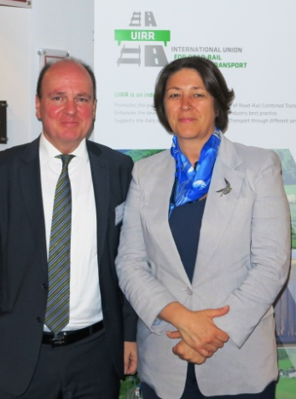
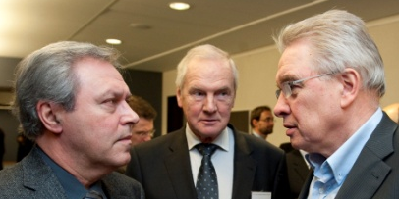
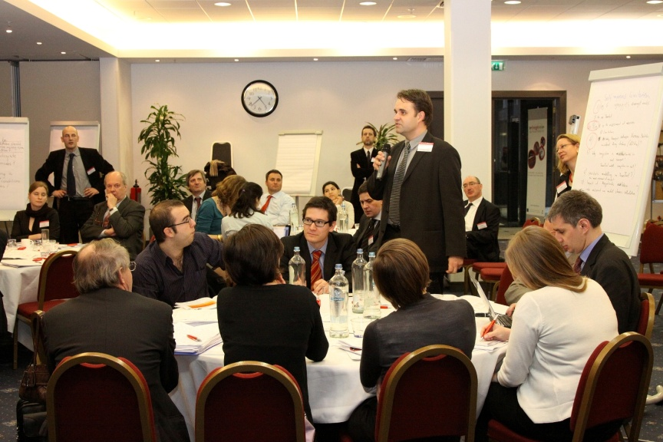
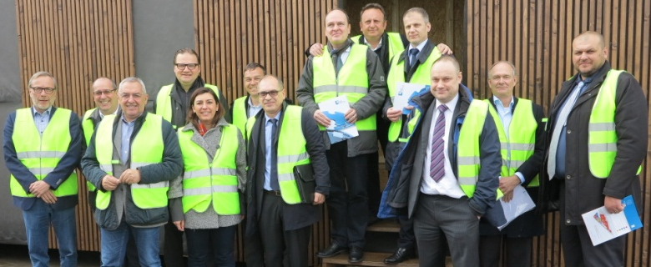
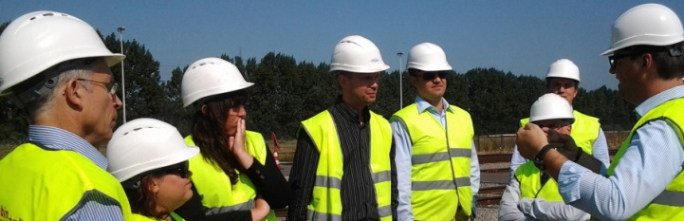
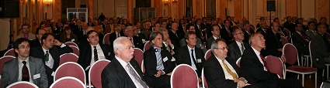
UIRR: 46 years of knowledge and experience
7
Promotion • Enhancement • Support
of European Combined Transport
CT Operators (Authorised Applicants) • CT Terminals

Slide 8
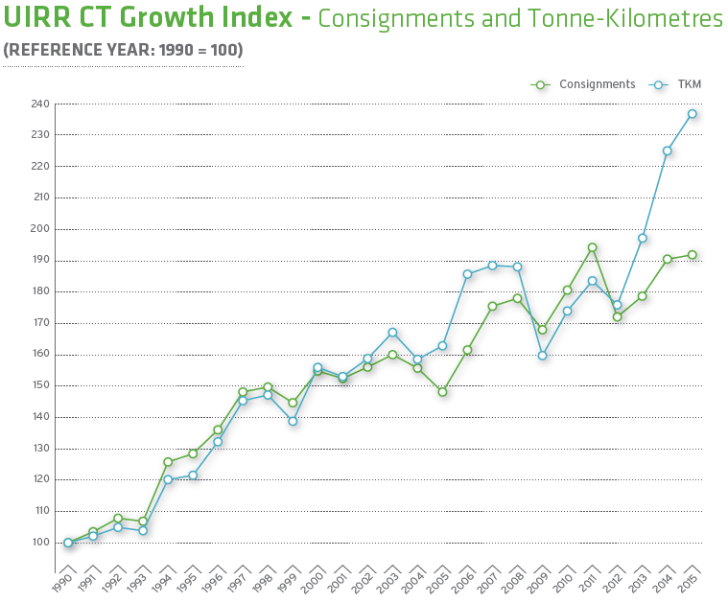
UIRR – Growth index of Members 1990 – 2015
8

Slide 9
Contents
Introduction of UIRR, the industry association of Combined Transport
Properties of Combined Transport
The challenges of longer distance freight transport
The European solution to the problem
Intermodal freight transport to facilitate modal shift

Slide 10
High density longer distance land freight transport
10
Intermodal Transport:
The most efficient way to insert ecologically sustainable modes of transport – like electric rail, inland navigation and short sea shipping – into long(er) distance transport-chains

Slide 11
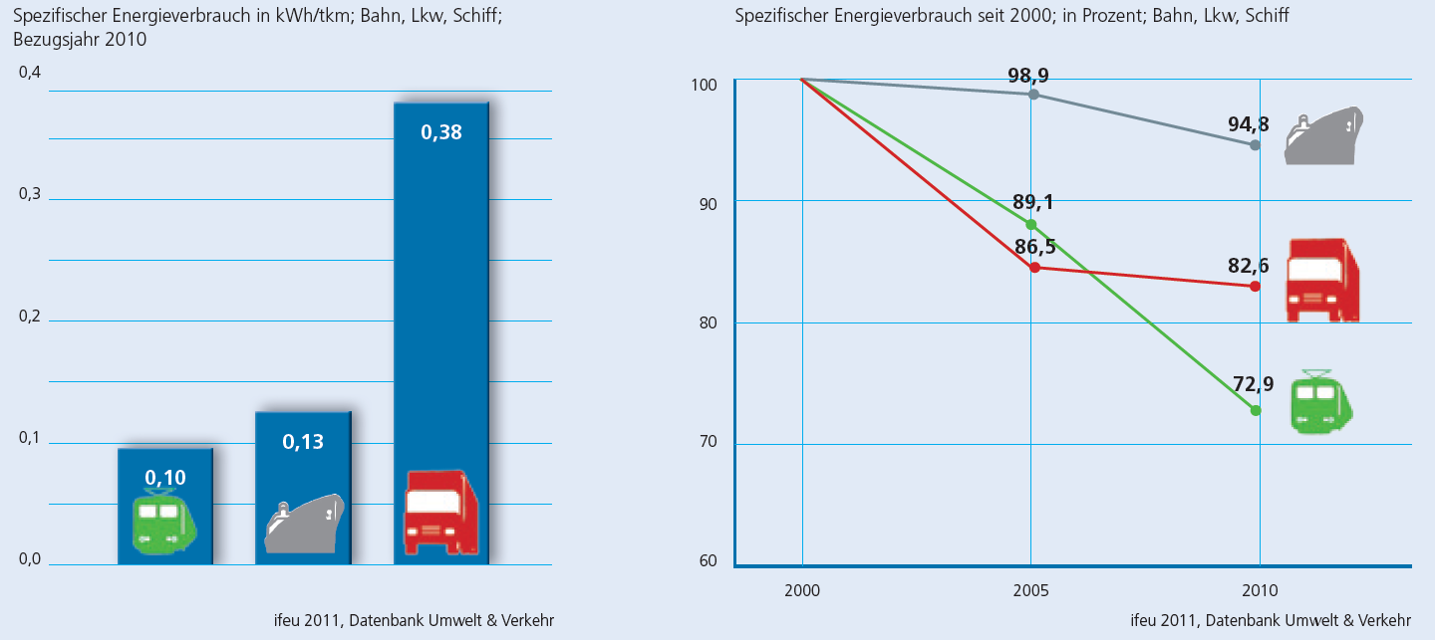
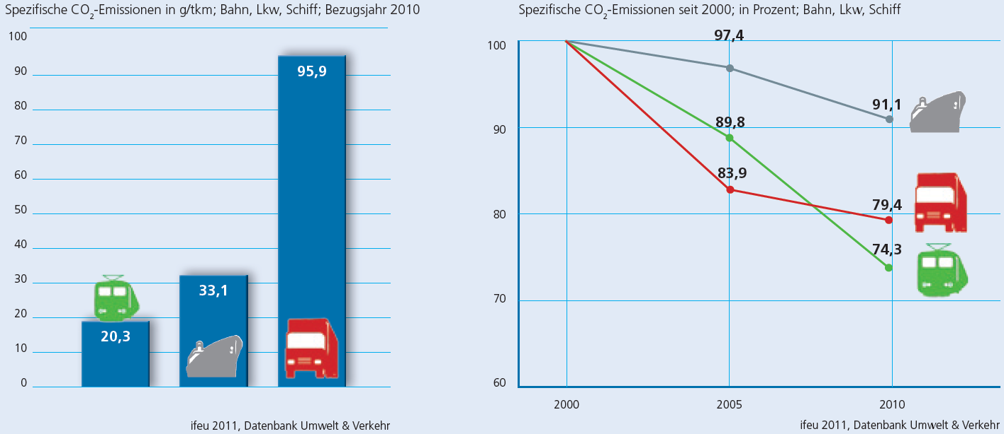
Primary energy need and CO2 performance of modes

Slide 12
Safety performance comparison
Safety category | Road | Rail
Fatalities in 2009¹ | 35 000 | 34
Accident occurrences: (i) road¹ and (ii) rail² | 1 200 000 | 1152
Accident occurrences: (i) HGVs, (ii) freight trains | 31 per 100M vkm² | 1,05 per 100M vkm³
Accident externality cost of (i) HGVs on motorways, and (ii) trains | €68 667 per 100M tkm⁴ | €238 per 100M tkm⁵
Road haulage is
30-times as accident prone as rail
¹ Source: EC EU transport in figures [2011]
² Source: Alan C McKinnon at 2nd IRU/EU Road Transport Conference: “31 per 100M vkm” [2012]
³ Source: ERA 2011 Rail Safety report figure (tkm) converted to (HGV) vkm @ 30t/vehicle rate [2011]
⁴ Source: CE Delft IMPACT Study (internalisation handbook) converted into tkm @ 30t/vehicle rate [2008]
⁵ Source: CE Delft IMPACT Study (internalisation handbook) converted into tkm @ 800t/train rate [2008]

Slide 13
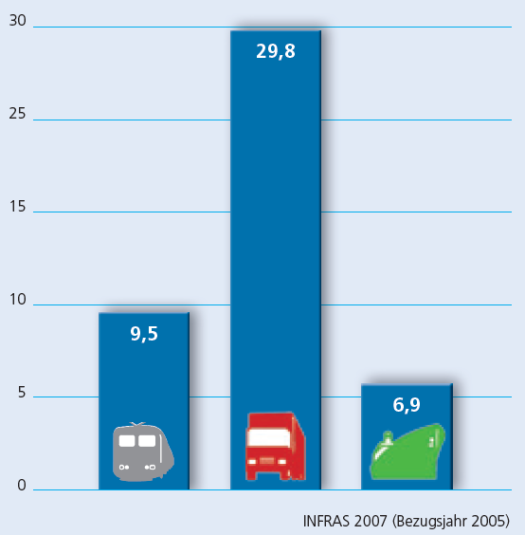
External costs of modes
External costs of rail: 33% of road
Ro-Ro and smaller vessels perform worse

Slide 14
The relative competitive situation of modes
Two principles should be equally upheld:
user-pays
polluter-pays
The de-politicisation of transport - no more budget transfers - would be needed to make transport truly market based and competitive in a fair manner.

Slide 15
Contents
Introduction of UIRR, the industry association of Combined Transport
Properties of Combined Transport
The challenges of longer distance freight transport
The European solution to the problem
Intermodal freight transport to facilitate modal shift

Slide 16
The challenges of longer distance freight transport
The answer: Intermodal/ Combined Transport
Energy efficiency
Accidents: injuries and fatalities
Congestion
Road degradation
PM10 pollutants noise
CO₂ emissions
Labour productivity
Oil dependency
Climate: CO2 and energy efficiency
Environment: pollution
Public security: oil dependency
Safety: accident injuries/fatalities and material losses
The economy: GDP loss due to congestion
Employment: low productivity and low paying jobs
Infrastructure: increased degradation

Slide 17
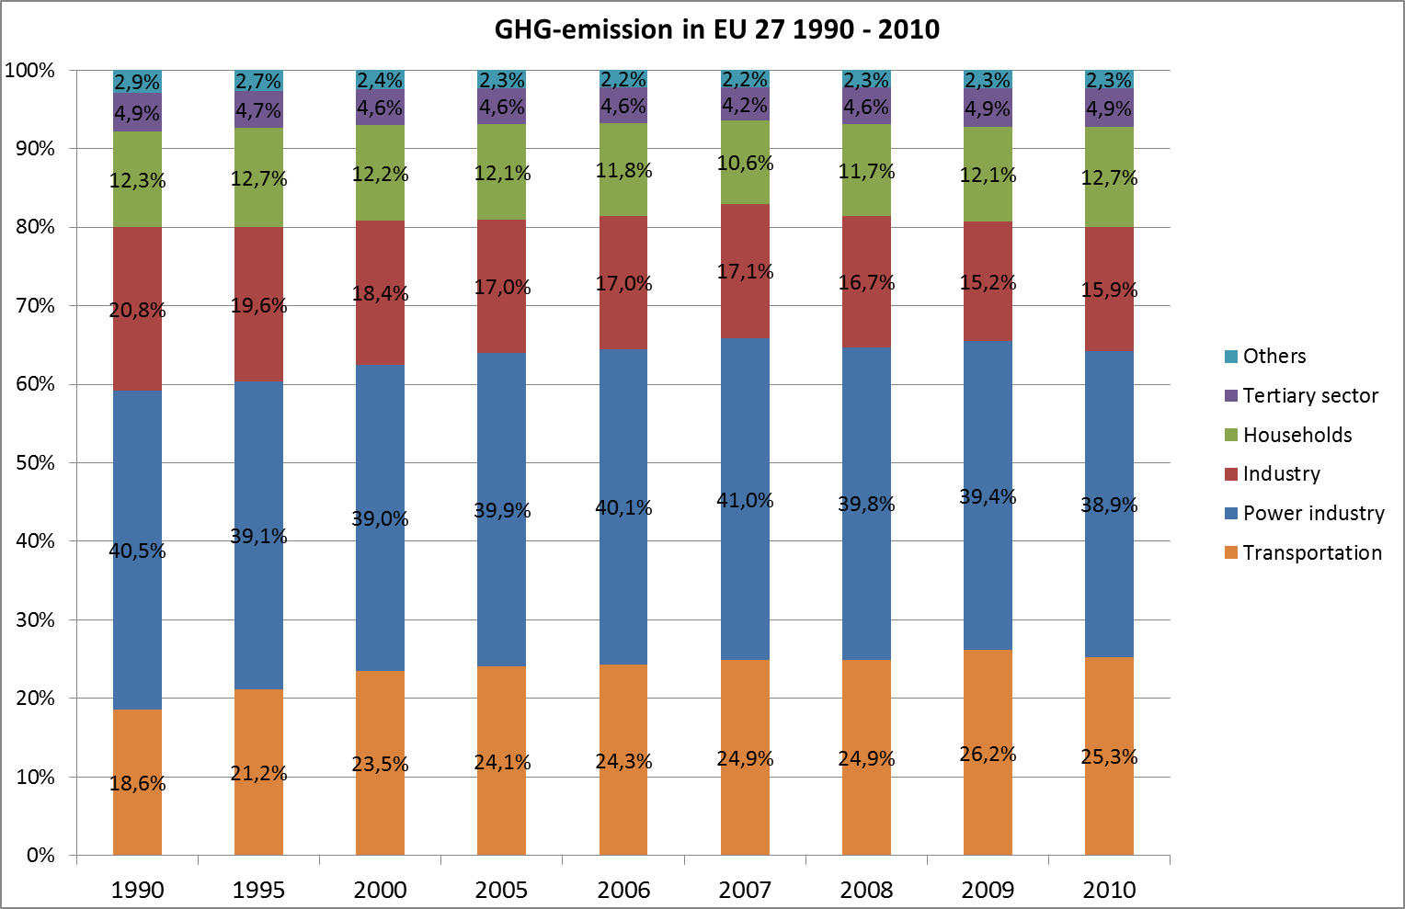
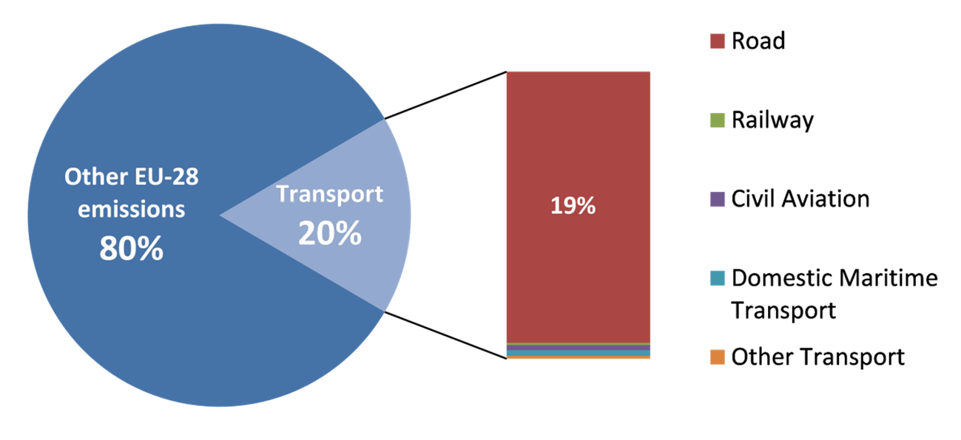
GHG-emissions of European Sectors: 1990-2010
17

Slide 18
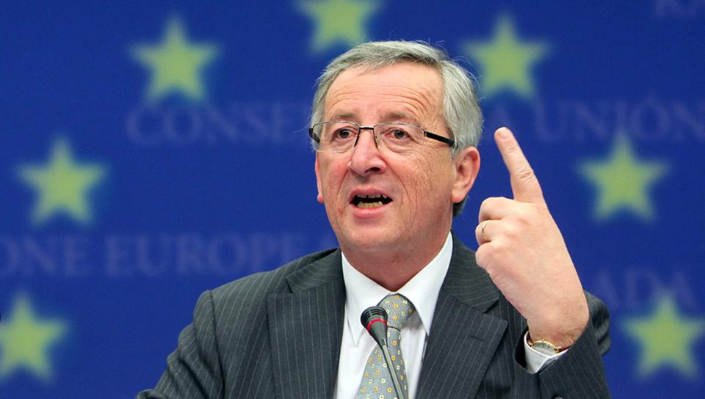
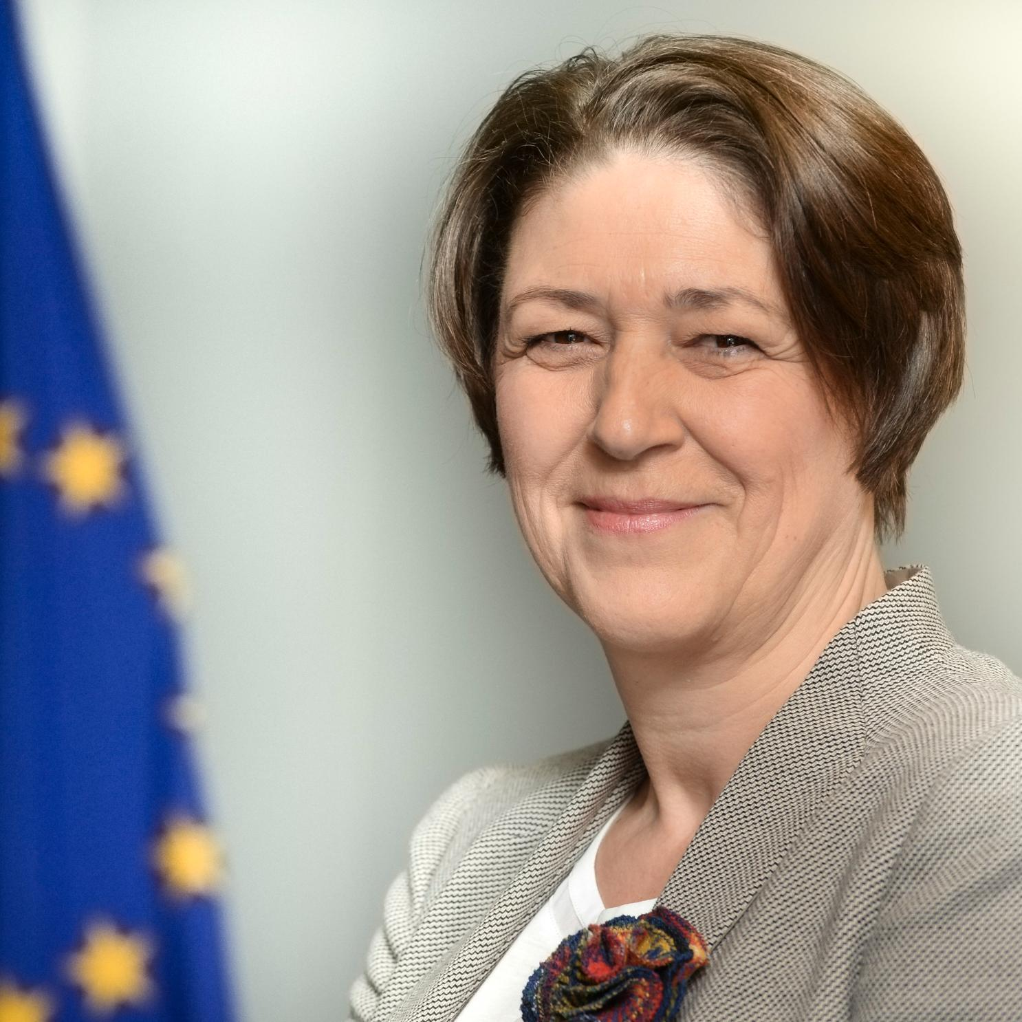
Mission letter of the new Transport Commissioner
18
”…the reduction of greenhouse gas emissions by the transport sector
contributes to the achievement of the overall EU target in this area.
This should be part of our overall effort to reinforce the sustainability of
our growth model.”

Slide 19
Contents
Introduction of UIRR, the industry association of Combined Transport
Properties of Combined Transport
The challenges of longer distance freight transport
The European solution to the problem
Intermodal freight transport to facilitate modal shift

Slide 20
EU 2011 Transport White Paper
Shift 30% of long(er) distance road tonne-kilometres realised over distances of 300km or more by 2030 from trucks to sustainable modes of transport - (electric) rail, inland navigation and shortsea shipping - which ratio should increase to 50% by 2050*
* on the basis of 2010

Slide 21
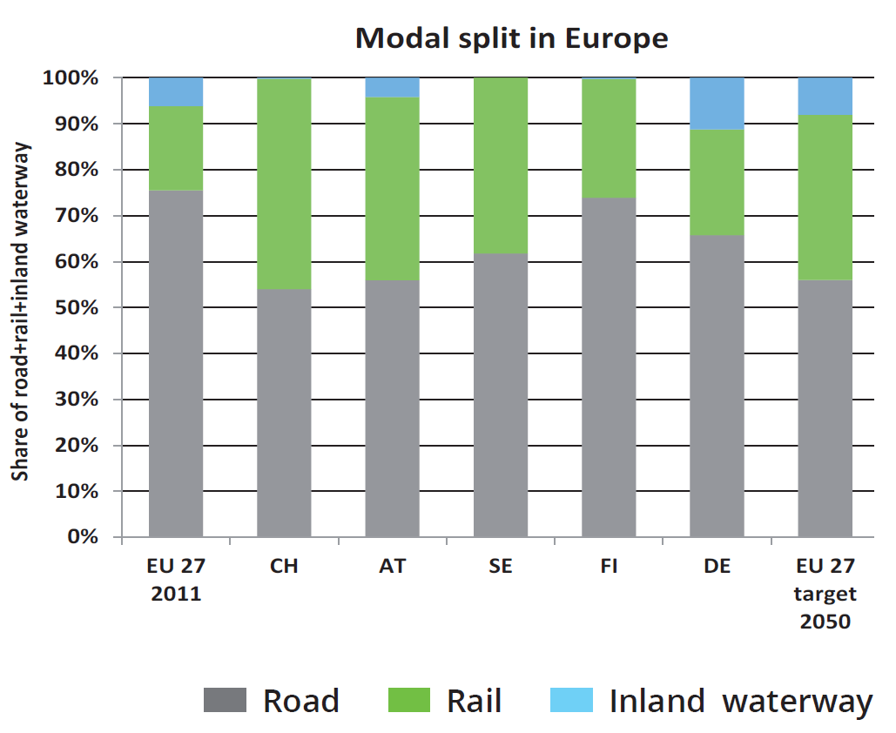
Modal split without SSS (coastal shipping)
=
Source: TRANSFORuM Project Report on Long Distance Freight, June 2015

Slide 22
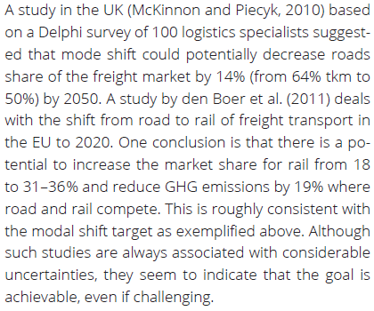
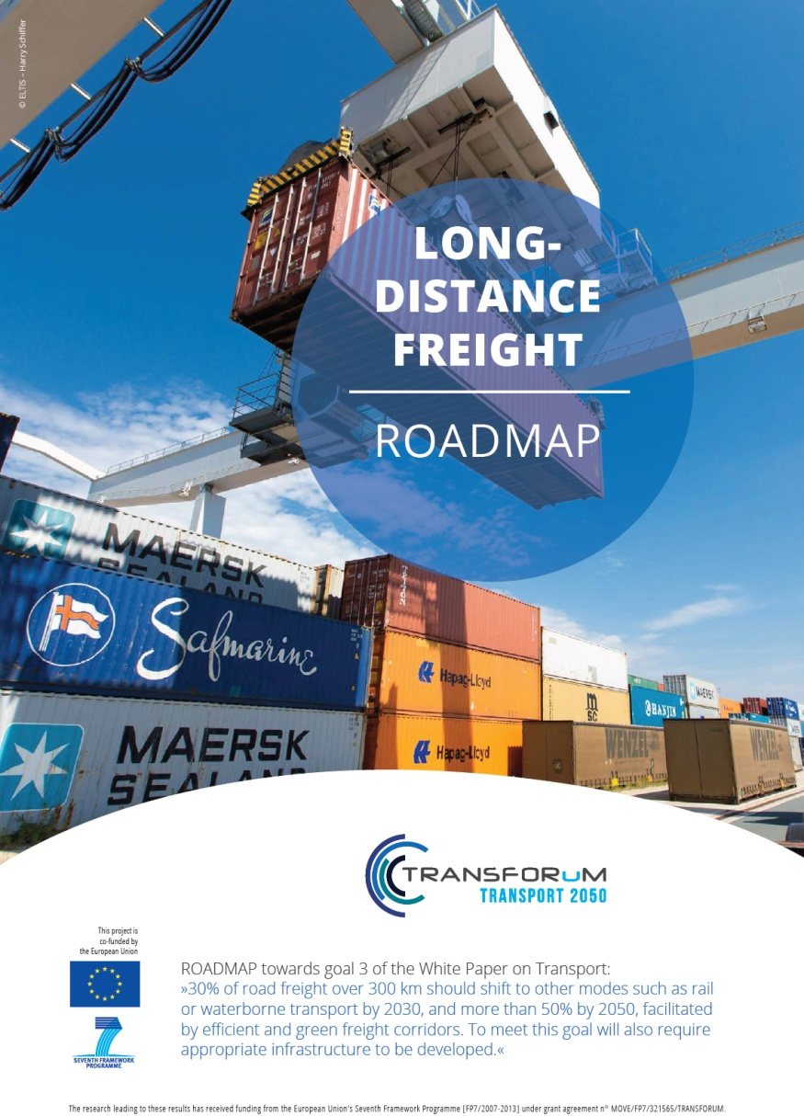
”Achievable, even if challenging”
Source: TRANSFORuM Project Report on Long Distance Freight, June 2015

Slide 23
Contents
Introduction of UIRR, the industry association of Combined Transport
Properties of Combined Transport
The challenges of longer distance freight transport
The European solution to the problem
Intermodal freight transport to facilitate modal shift

Slide 24
The task
24
The Beauty… (?)
and The Beast

Slide 25
The key to intermodality: switch to using the ”box”
25
Containerisation: the pre-requisite to unlock the benefits Combined Transport
HIGH VALUE
PERISHABLES
OVERSIZED
LIQUIDS
DANGEROUS GOODS
BULK
PALLETS

Slide 26
Intermodality brings together road, rail and maritime
Terminals provide the connection point to the different freight transport modes that collectively perform a single transport assignment.

Slide 27
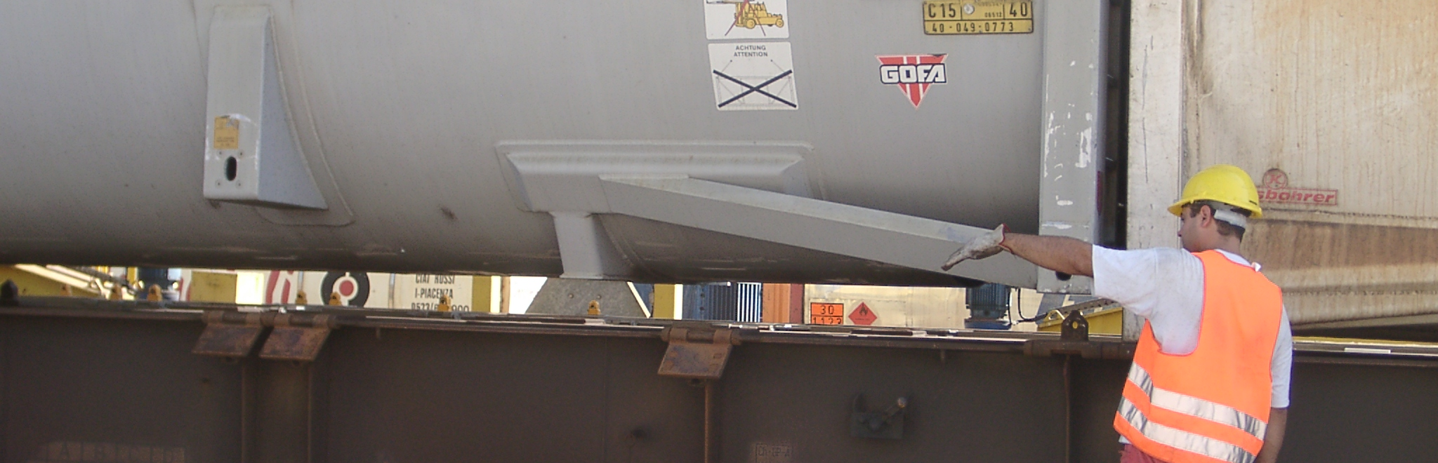
Thank you
For your attention
27

