Slide 1

COMBINED TRANSPORT IN THE SEE AREA
POSSIBILITES AND PERSPECTIVES
South East Europe Co Modality 2016
Plovdiv, 01 September 2016

Slide 2
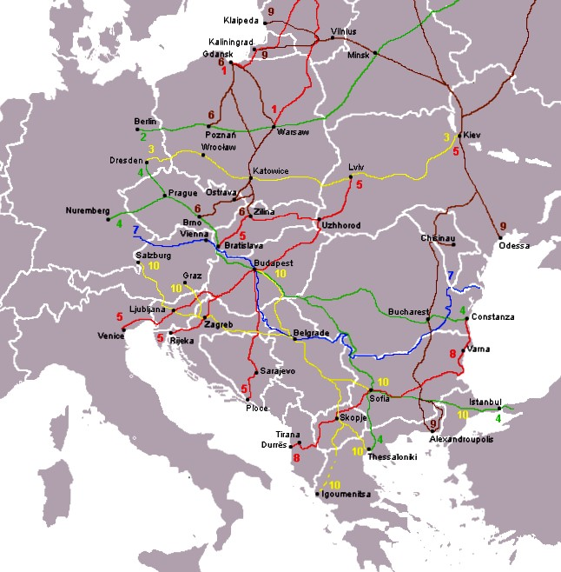

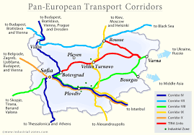
GEOSTRATEGIC ADVANTAGES OF
THE BULGARIAN RAILWAY TRANSPORT
Crossroad position of the country enabling the development of transit transport on the lines of the Pan-European transport corridors;
Link with five European transport corridors: IV, VII, VIII, IX and X;
Link with the OSJD corridors: No 6 (Czech Republic, Hungary, Romania, Bulgaria, Turkey, Iran, Turkmenistan), No 12 (Moldova, Romania, Bulgaria);
Link with the TRACECA transport corridor (Europe- Caucasus- Asia): through Burgas Port, Varna Port, Varna Ferry);
A railway link with the Black Sea ports of Varna and Burgas and the Danube ports Lom, Ruse, Svishtov, Silistra and Vidin.

Slide 3
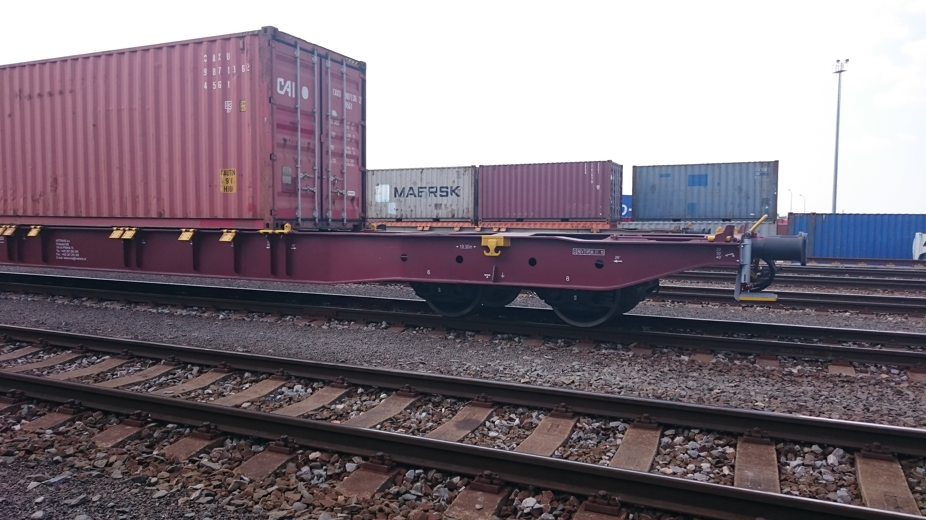
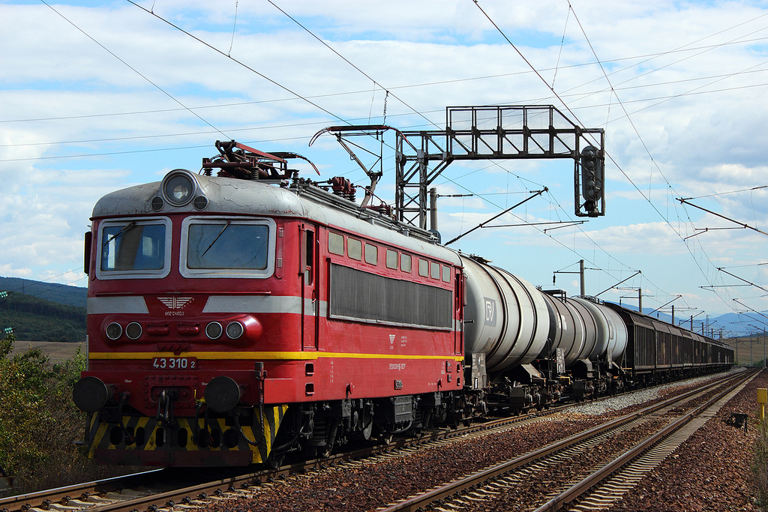
BDZ Cargo is the state railway freight operator of Republic of Bulgaria
The company occupies 56.5 % of the railway freight traffic market in the country
Freight traffic carried out in 2015: 8 315 000 tonnes
Length of the railway lines - 4 070 km
80 stations opened for loading/unloading activities
Experienced team of experts
Rolling stock fleet – 3000 freight wagons in daily operation
Traction fleet – 110 diesel and electric locomotives in daily operation
Strategically located network of locomotive and wagon workshops
Electronic system for document handling and tracking of trains

Slide 4
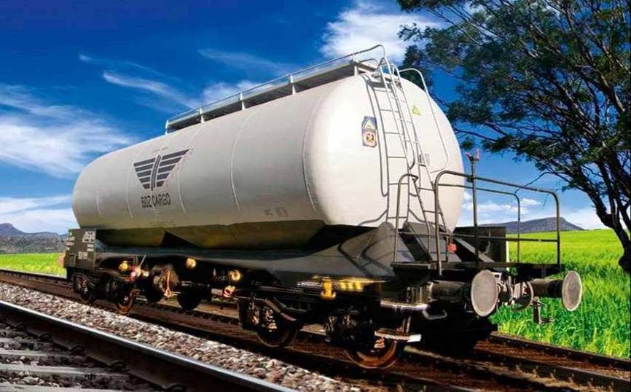
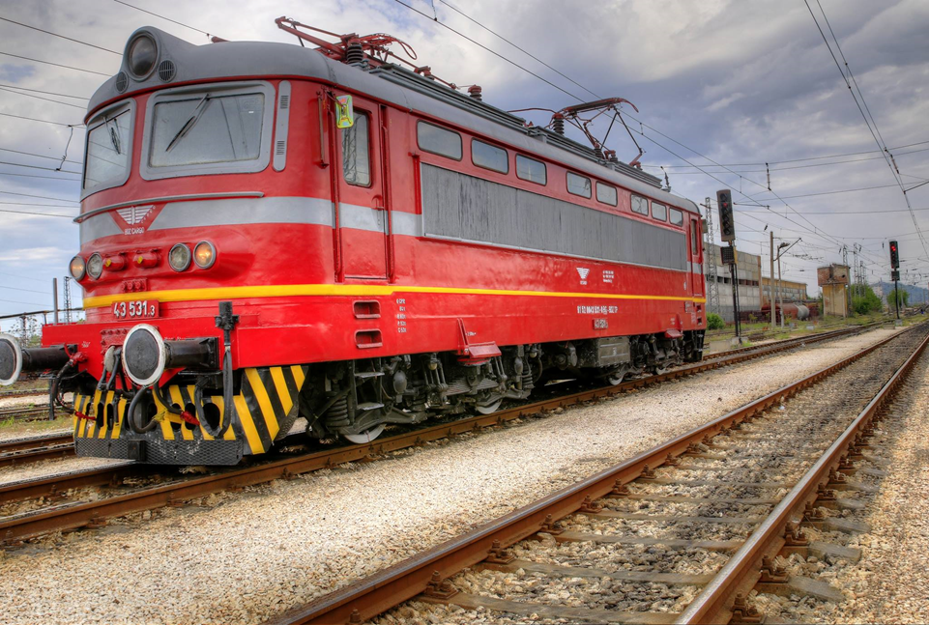
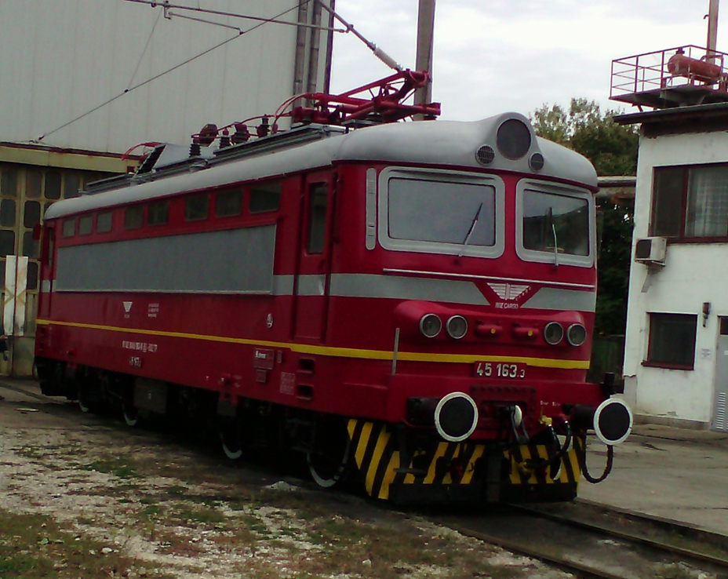
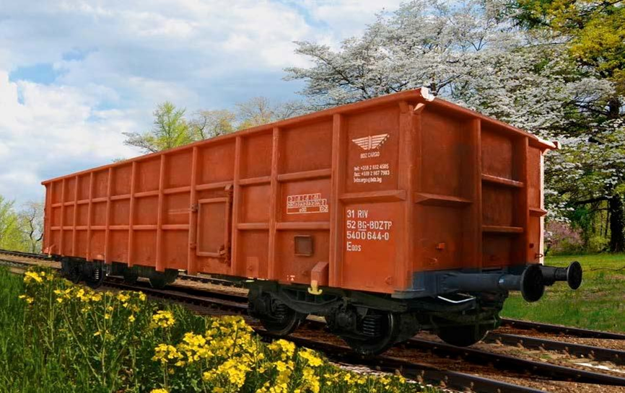
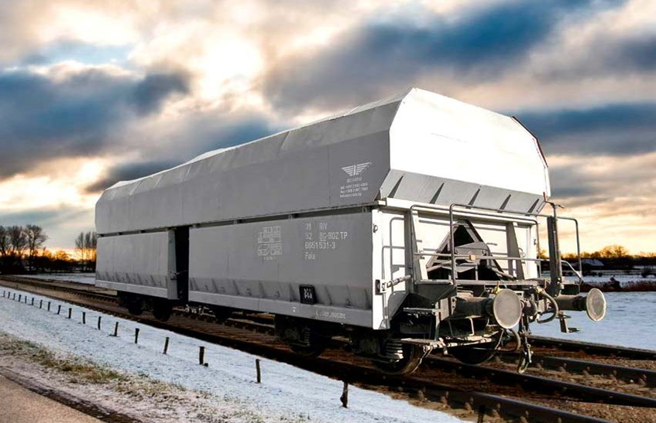
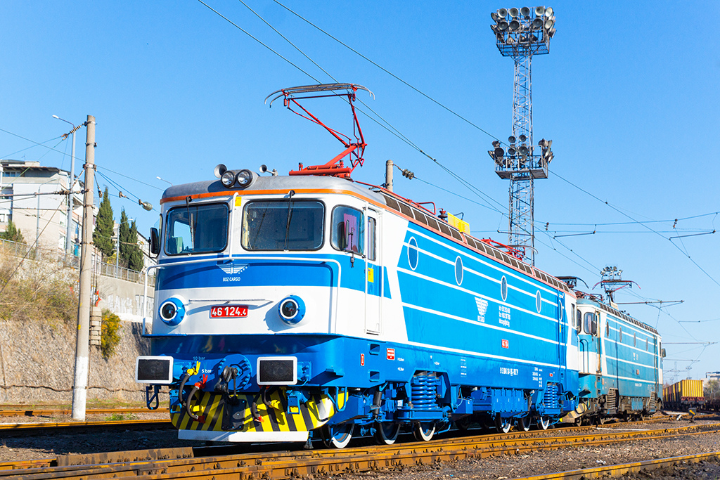
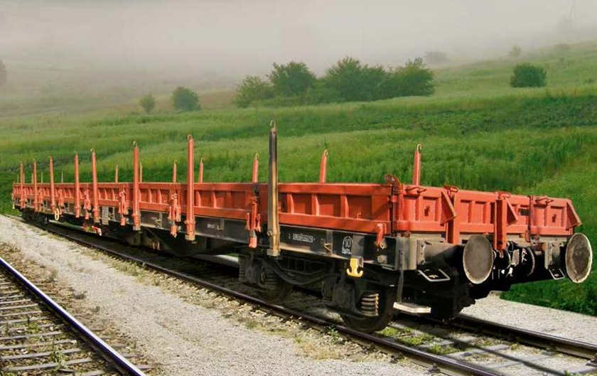
Rolling stock and traction fleet

Slide 5
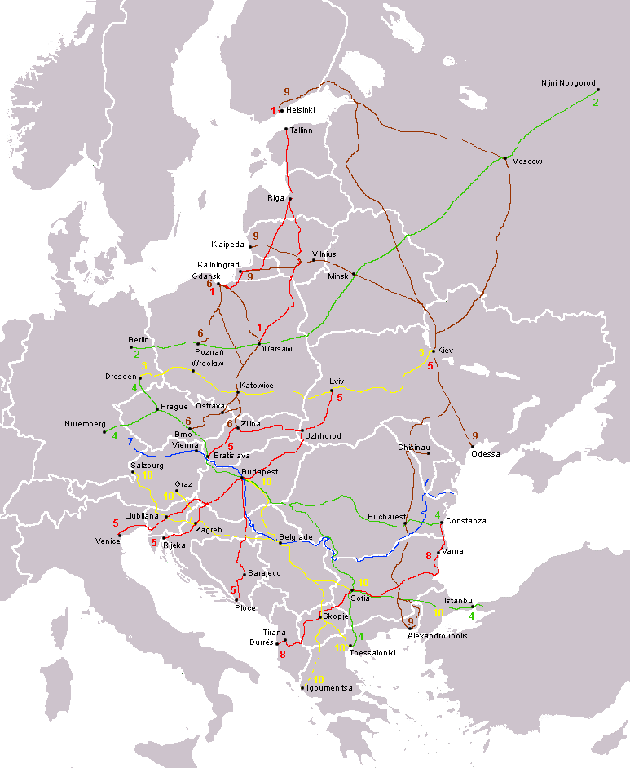
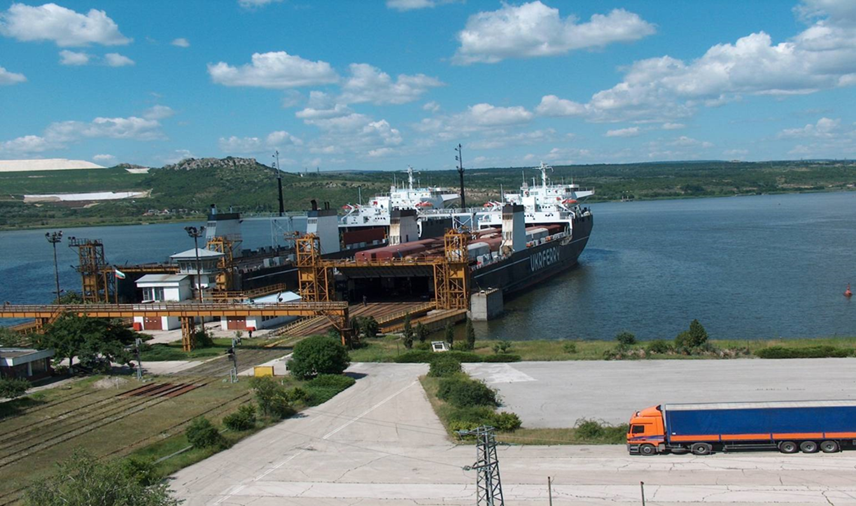
FERRYBOAT COMPLEX VARNA
BDZ Cargo is the only railway freight operator in the Ferryboat complex Varna.
Ferryboat lines served:
Varna - Ilichevsk
Varna – Ilichevsk – Poti/ Batumi
Varna – Caucasus
Combined transports:
Transport of goods in wagons
Transport of trucks/ semi-trailers
Transport of containers
Other deck loads and automobiles

Slide 6
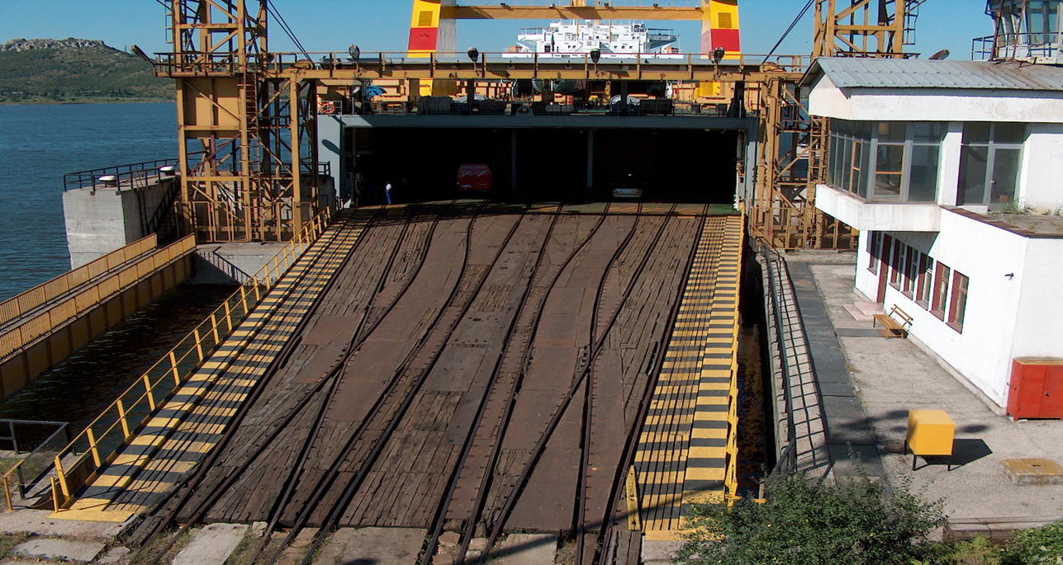
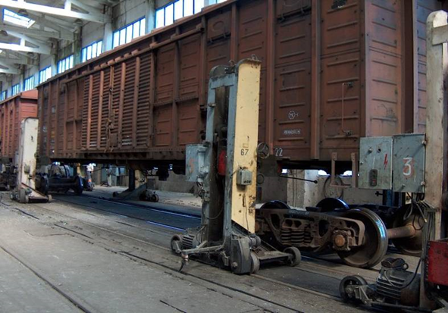
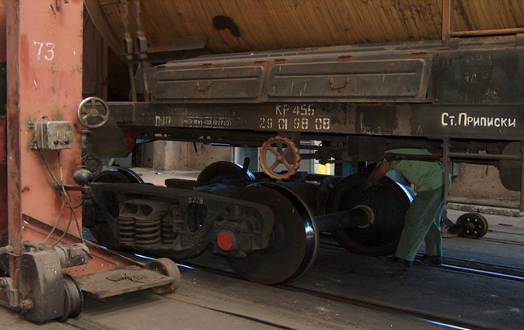
TECHNICAL CHARACTERISTICS
AND EQUIPMENT
WORKSHOP FOR CHANGING
BOGIES
The complex has two piers with total length of 400 m and depth of 8,7 m, equipped with transitional bridges, each of which with 5 tracks with gauge 1520 mm. The complex has a capacity for a simultaneous handling of two ships and also for handling of two types of ships – with width 26 and 22 m. Technical capacity for direct transshipment of 80 wagons per day
The ferryboat complex Varna is the only place in the Black Sea region with possibility for changing wagon bogies from European (1435 mm) to Russian standard (1520 mm) gauge. The workshop is equipped with two universal tracks, with 12 positions each. It has the capacity for changing the bogies of 280 wagons per day.

Slide 7
MAIN SERVICES
ACCOMPANYING SERVICES
Transport of goods in block-trains
Transport of goods in isolated wagons
Combined transports
Transport of goods in route trains on routes, timetables and prices coordinated with the other RUs
Transport on specially agreed transport schemes
Transport of heavy-load, out-of-gauge and special consignments
Transport of goods from/to the Black Sea ports Varna and Burgas, also in large-capacity containers, processed in the terminals of these ports
Transport of goods from/to the Danube ports Ruse, Lom, Svishtov, Vidin
Transport via the railway ferry lines connecting port Varna, port Caucasus (Russia), port Ilichevsk (Ukraine), ports Poti/ Batumi (Georgia), continuing the transport by rail from/to the countries of CIS, Central and Middle Asia.
Customs clearance, financial guarantees, security and insurance for goods
Routing
Warehousing
Tracking and tracing of wagons and containers
Container terminals and logistic services
Rental of locomotives
Other shipping services

Slide 8
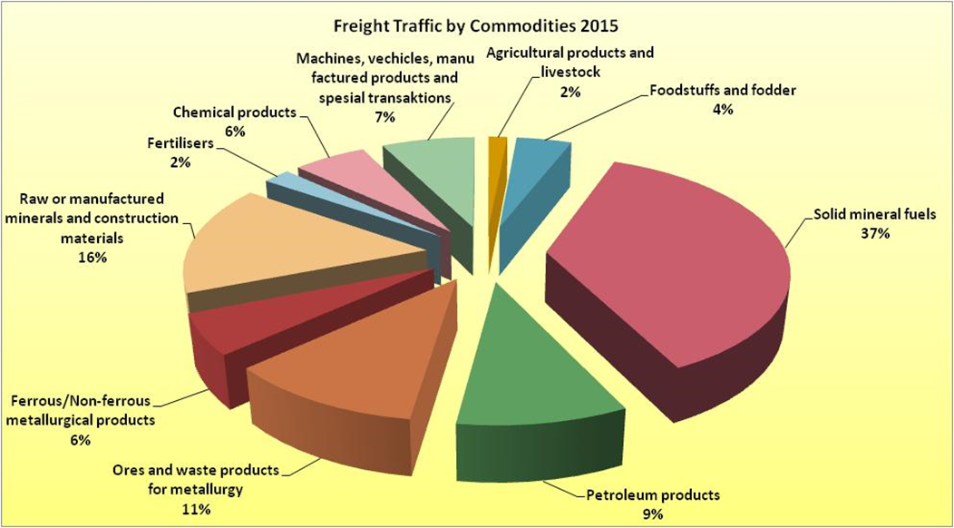
FREIGHT TRAFFIC

Slide 9
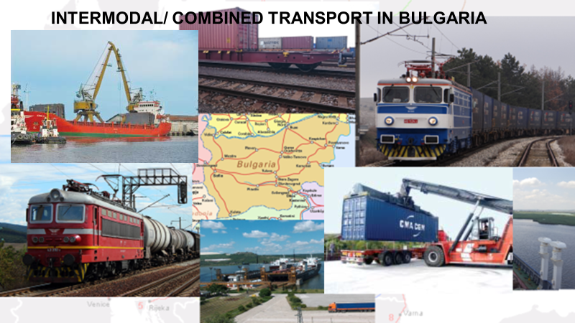

Slide 10
DEFINITION
The following definitions are given by the United Nations Economic Commission for Europe: Combined transport is intermodal transport where the major part of the European journey is by rail, inland waterways or sea and any initial and/or final legs carried out by road are as short as possible.
The Railway Companies offer two types of intermodal transport :
- Accompanied transport, also known as "rolling road".
- Unaccompanied transport, changing from one mode of transport to another using a purpose-built terminal (road, maritime, waterway, rail, air).
Intermodal transport: The movement of goods in one and the same loading unit or road vehicle, which uses successively two or more modes of transport without handling the goods themselves in changing modes. By extension, the term intermodality has been used to describe a system of transport whereby two or more modes of transport are used to transport the same loading unit or truck in an integrated manner, without loading or unloading, in a door to door transport chain.

Slide 11
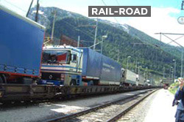
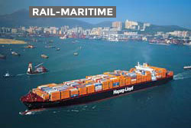
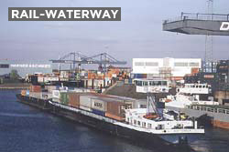
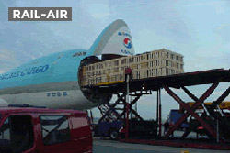
TECHNIQUES

Slide 12



BENEFITS
Combined Transport presents a range of benefits. It contributes towards a better quality of life and proposes a seamless transport solution in order to improve the productivity of the entire chain.
The main benefits of combined transport can be summarised as follows:
Friendly towards the environment: on routes where volumes can be bundled and distance is appropriate, combined transport provides substantial energy gains and lower CO2 emissions
Friendly towards society: reduces accidents, road congestion and dependency on energy reserves
It allows for a better use of existing capacity
It combines the flexibility of road with the economies of rail on long journeys for large volumes
It is well integrated in the logistics chain; quick and easy handling
It is safe and secure: reduce risk for goods during the transport journey
IT tools for tracking of goods

Slide 13
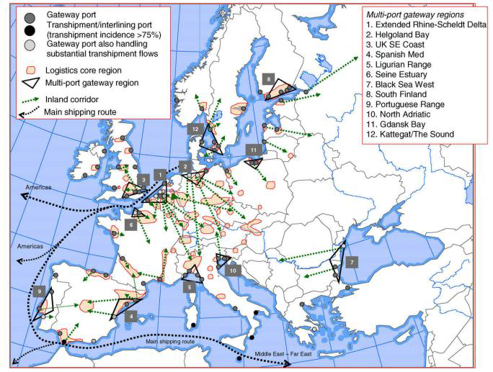

Slide 14
Combined transports in the Balkan region
Road corridors
Road corridors throughout the region are well defined and in general have an acceptable international standard of vertical and horizontal alignment geometry. Most of the roads serving international traffic currently operate within capacity and therefore the main emphasis in the short term must be on road rehabdttation and improvement in safety characteristics.
Rail network
The railway networks are extensive, with a reasonable geographical spread offering good coverage of the principal cities. Numerous projects with EU and nationa funding for rehabilitation and modernization of rail section have already been implemented or are ongoing.
Ports and short sea shipping
There has been significant growth in short sea shipping services in the Balkan region over the last years, particularly in ro-ro services which bypass the Balkan land corridors between Greece and Turkey on the one hand and the EU on the other. Significant investments and development of the sea port in the region, increase of the container and ro-ro traffic flow through the ports. All have sufficient existing capacity or have well-established plans for expansion and associated
improvements to road and rail access where required, to meet current and projected medium-term demand.
Inland waterways
The main inland waterway running through the Balkan region is the River Danube which is the second longest river in Europe. Whilst the potential for the transport of goods along the Danube is considerable, there remain a number of infrastructural and institutional factors that hinder the development to its full potential. The short-term problem is the need to attract new traffic to the Danube and to revitalise the existing ports so that they become logistical centres capable of meeting tomorrow's transport requirements.

Slide 15
BULGARIA
Bulgaria has established a very comprehensive infrastructure …
9 Rail motorways, some under development
80 Railway stations opened for loading/unloading cargo
4 international airports
2 major seaports on the Black Sea
4 major river ports on the Danube
Free zones
… that is constantly developed …
Investments under Operational Programs/ EU funded projects
The railway infrastructure is being modernized and the max speed supported by the railway tracks will reach 160 km/h
Ship transport conditions in critical areas on the Danube river are improving
Ongoing construction of several intermodal terminals in strategic areas
… and provides opportunity for intermodal transportation by air, sea, rail and road - receiving and redirecting cargo traffic.

Slide 16
BULGARIA
Undisputable facts:
- The Bulgarian transport and logistics sector is among the best developed on the Balkans
- Big international companies opened logistic centers in Bulgaria
- Most goods are transported to the emerging markets on the Balkans and the developed EU countries
- International transportation has been stable and growing in the past years despite the global crisis

Slide 17
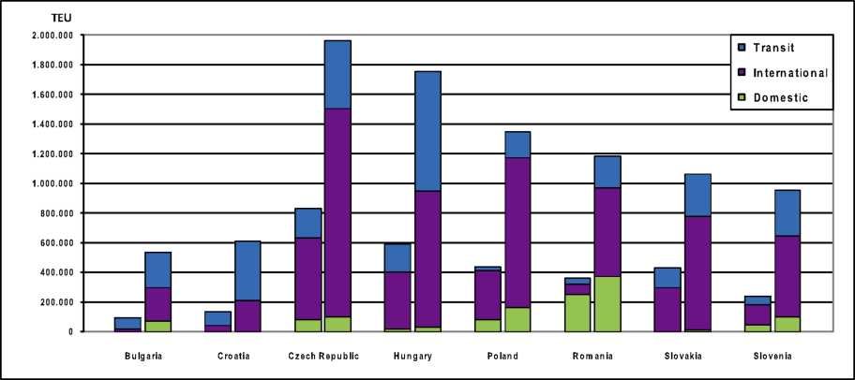
Development of the intermodal traffic by 2020
Unaccompanied intermodal traffic volume /TEU/ - 2010/ 2020
Key drivers of freight volume and market potential development
Manufacturing industry
EU Single Market
Globalization
Improvement of the transport infrastructure and rail/ road/ port services
Development of the intermodal industry itself
Governmental policies, climate policy
Strong competition in the transport sector

Slide 18
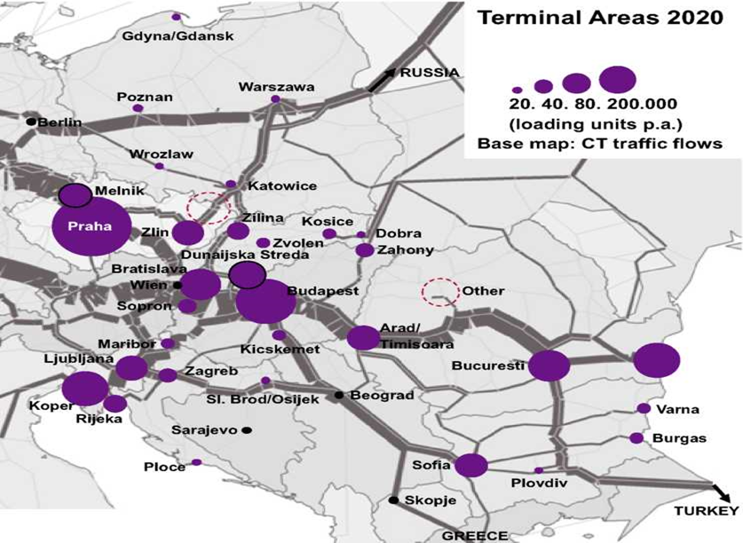
Terminal areas by 2020

Slide 19
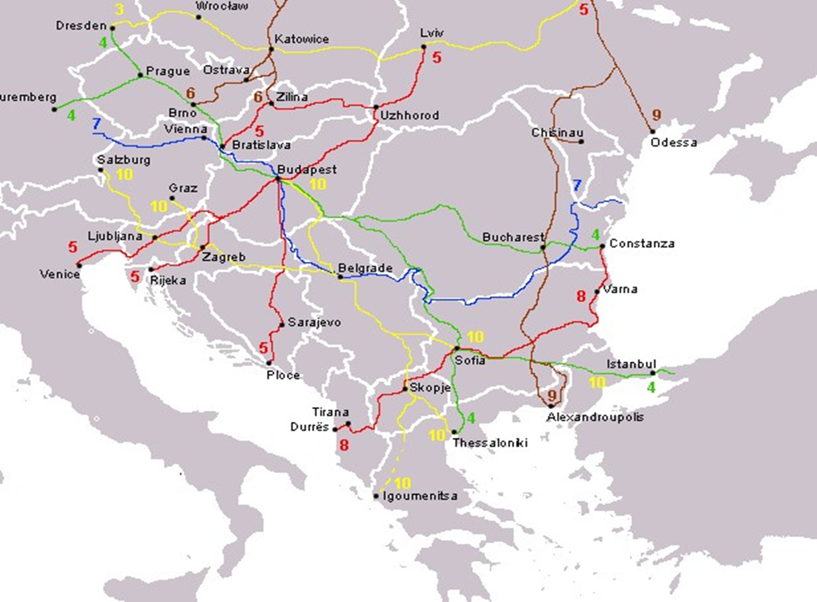
EXPECTED INTERMODAL TRAFFIC
Western/ Central Europe – SEE countries, Turkey, Middle East and vice versa
Port of Piraeus – Sofia /with further extension to Romania
Port of Piraus – via Bulgaria to Central Europe
Port of Thessaloniki – Sofia
China/ Middle East - Port Varna/ Burgas to Bulgaria or for further distribution to the countries from the Balkan region or Central/ Western Europe
Black sea
Burgas
Piraeus

Slide 20
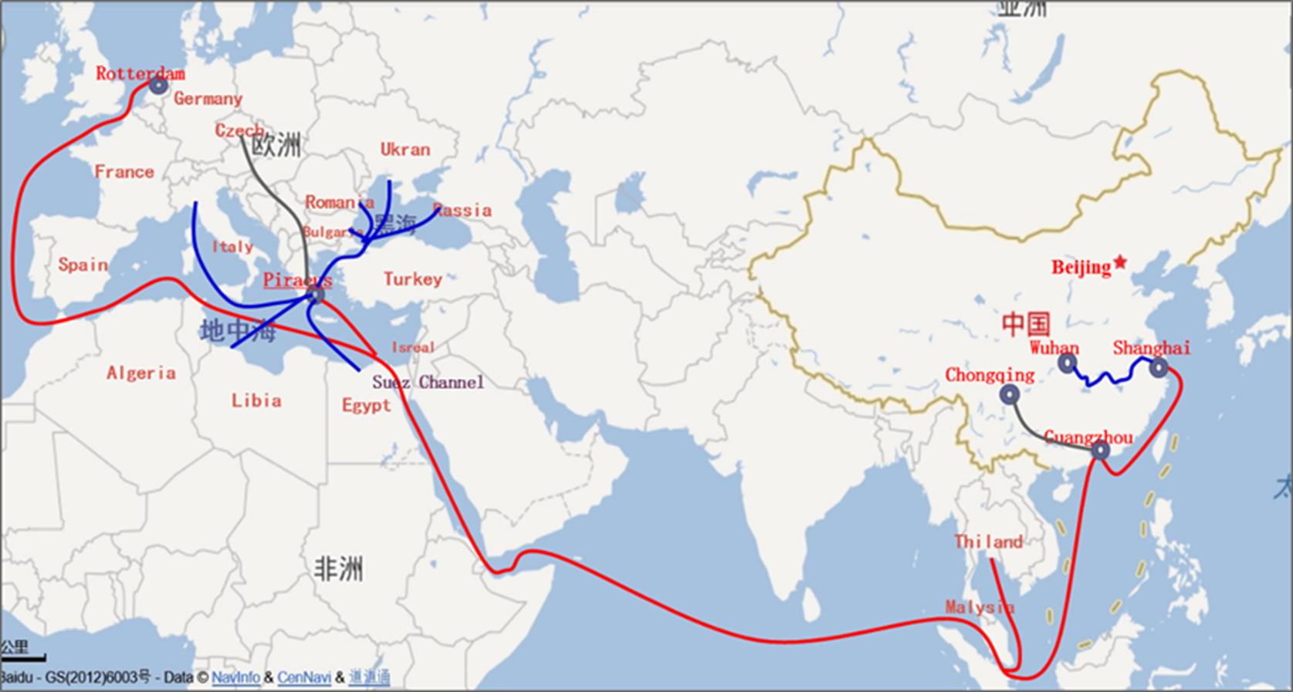
Distribution of goods
from China via Balkans allover Europe /via the Greek ports Piraeus and Thessaloniki/
EUROPE – ASIA KEY PROJECTS

Slide 21
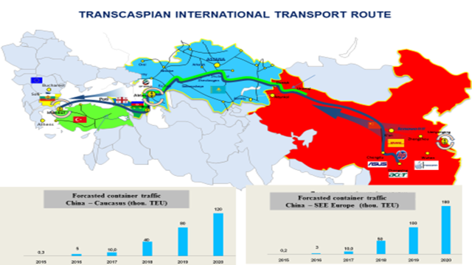

Slide 22
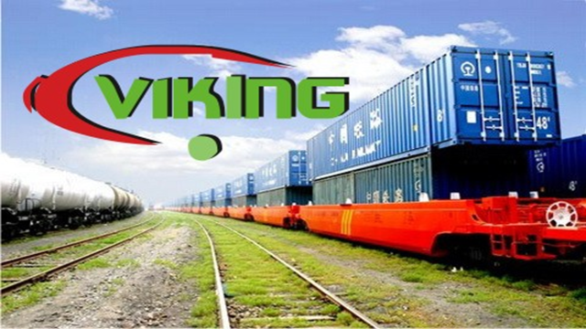
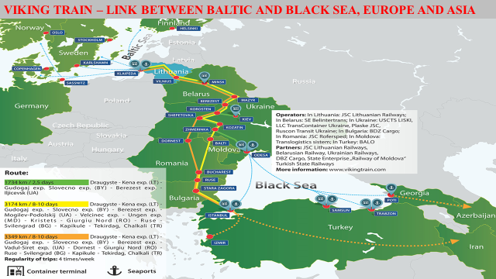

Slide 23
RECCOMENDATIONS
Seamless international intermodal services: Interoperability, synchronization of processes between railways and operators, data interchange: tracking of shipments.
States shall ensure level playing field between road and rail concerning infrastructure access charging and establish incentive schemes to support intermodal traffic.
Sufficient financing of rail infrastructure upgrading projects and timely completion of planned measured. Securing sufficient network capacities for freight.
Terminals: new sites and upgraded infra- and superstructure capable for all types of intermodal loading units (not only container but also swap bodies and in particular semi-trailers).
Cooperation, Collaboration, Coordination between all modes of transport for development of the intermodal transport in the area.

Slide 24
THANK YOU FOR THE ATTENTION!
Lyubomir Iliev
General Manager
BDZ Cargo
Mob.: 00359 889 144166
liliev@bdz.bg
www.bdz.bg

